Slide 1
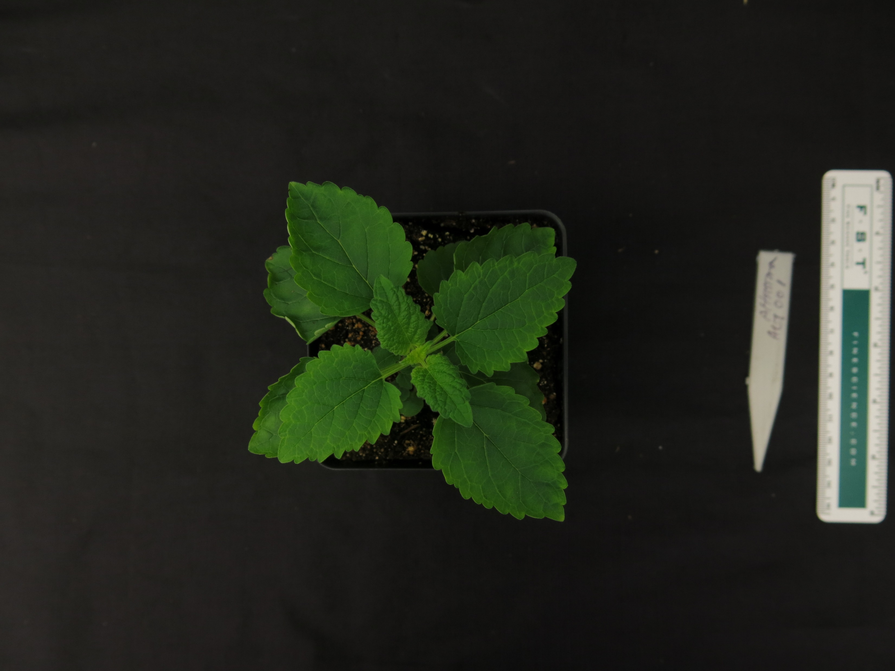
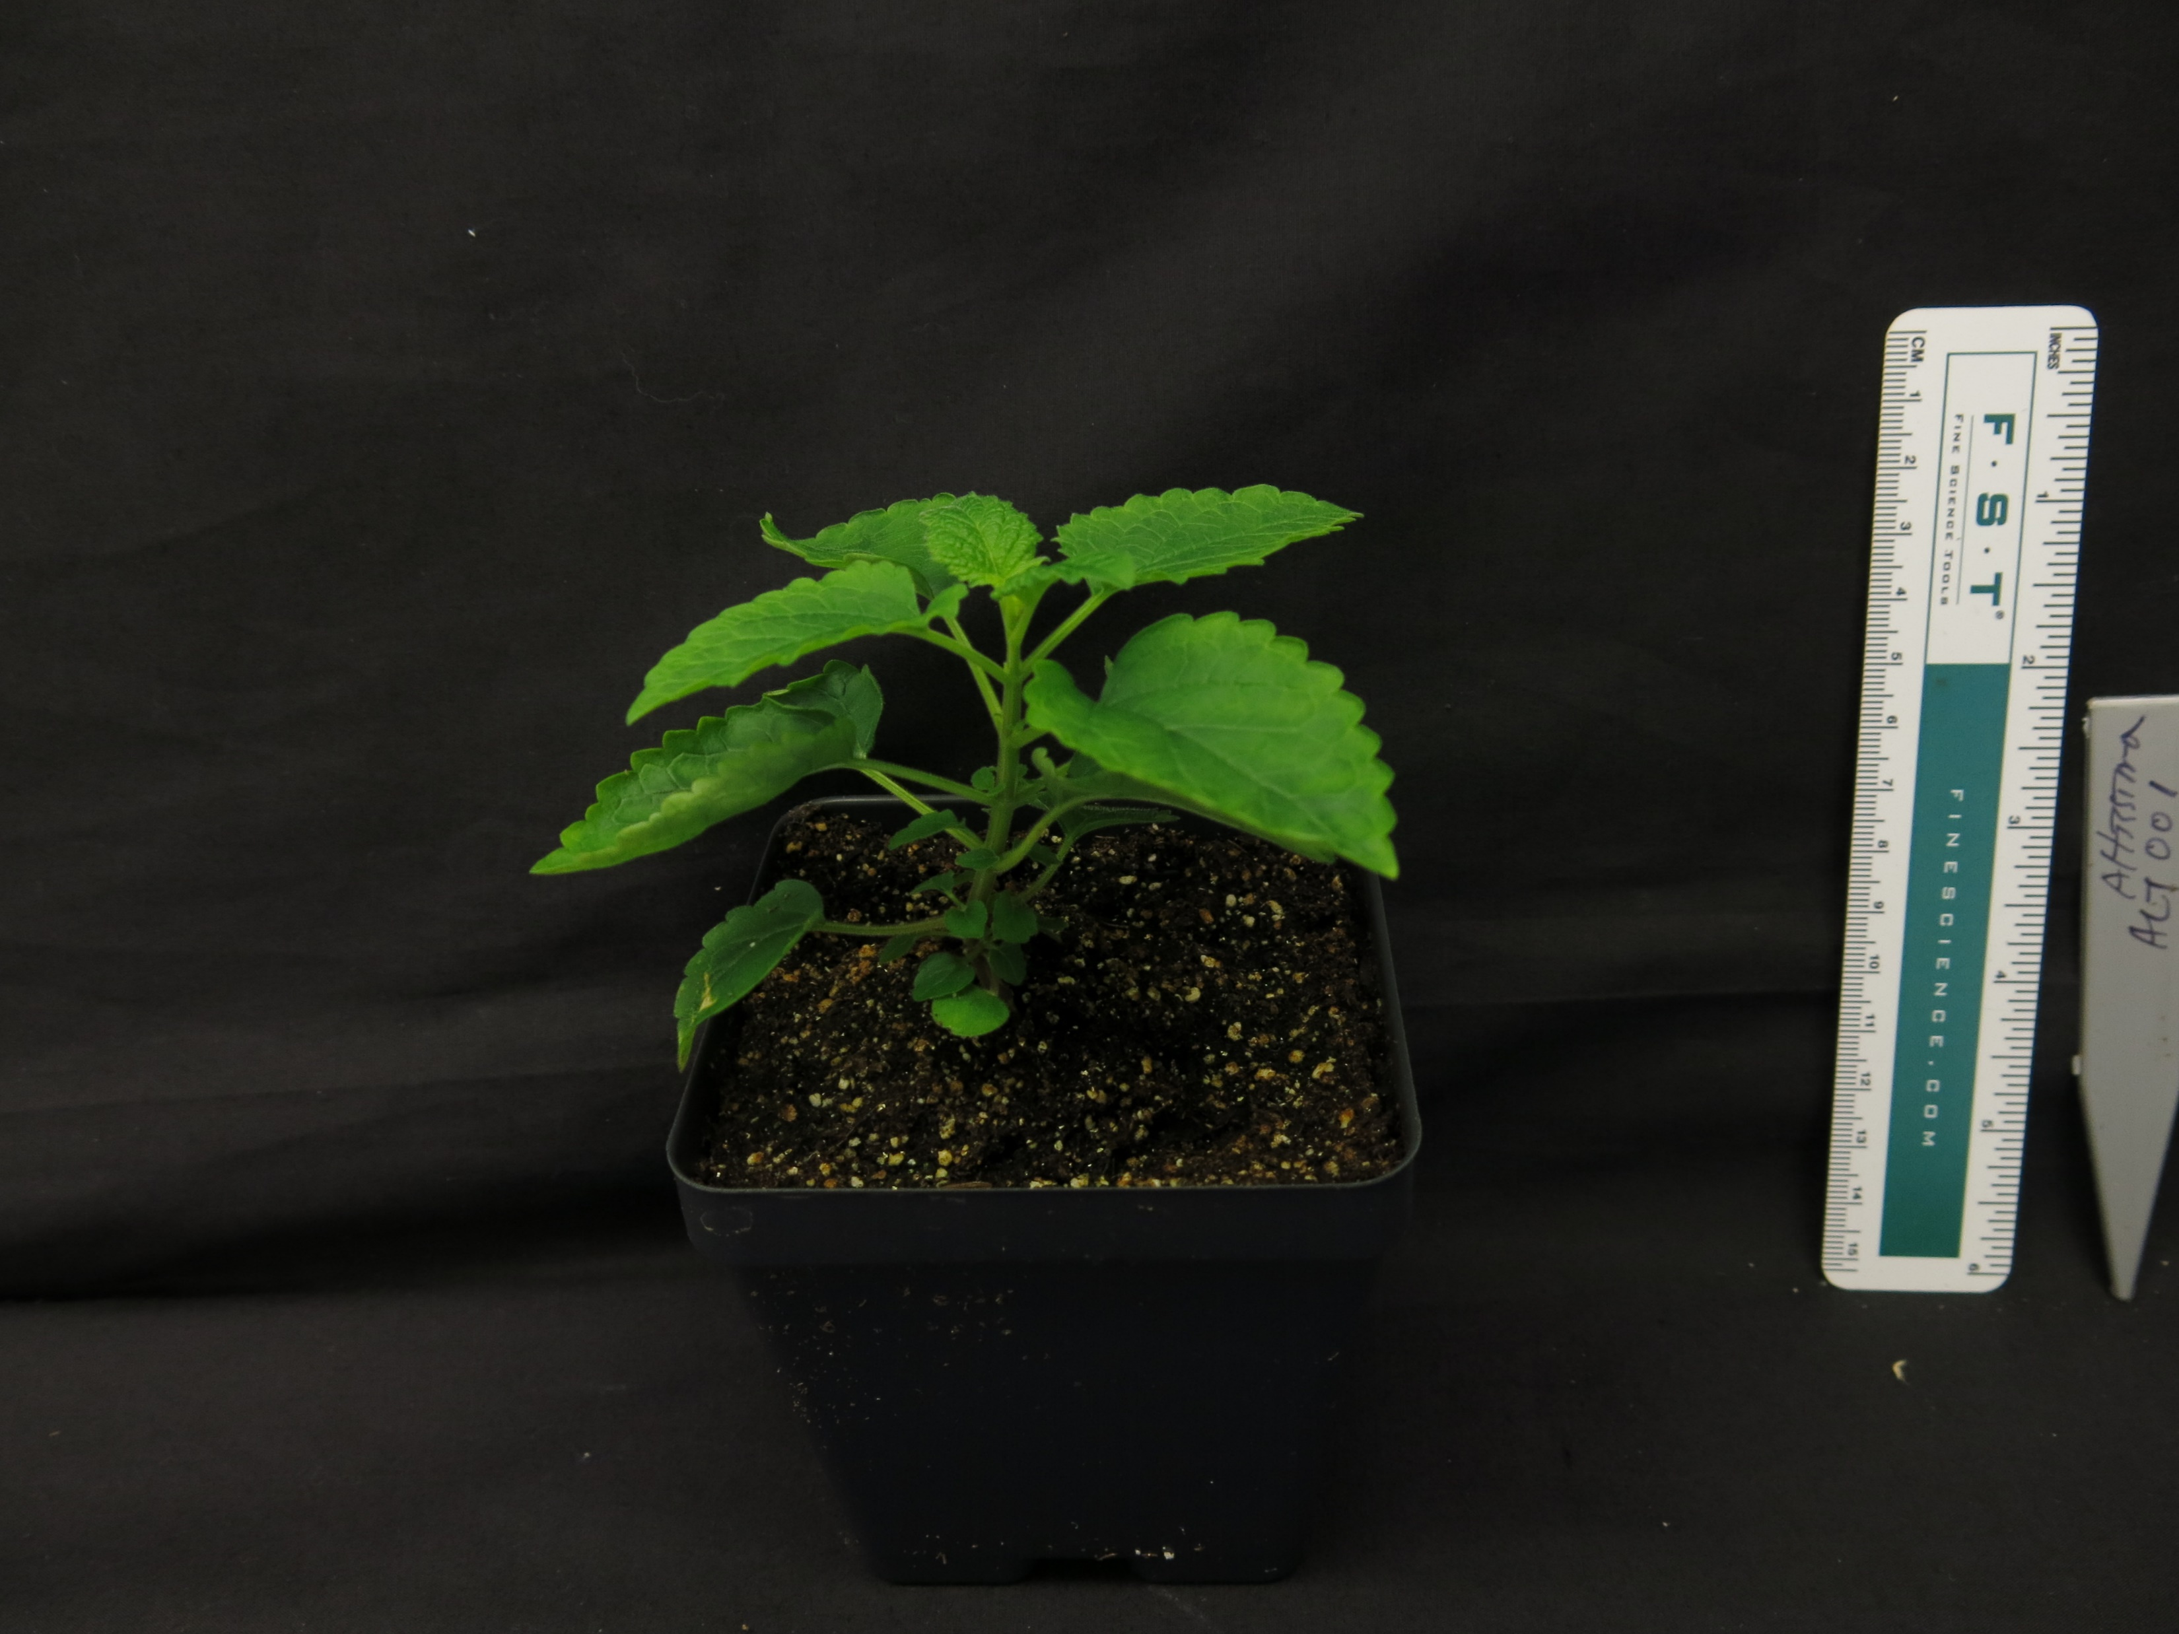
Scutellaria altissima (40 days)

Slide 2
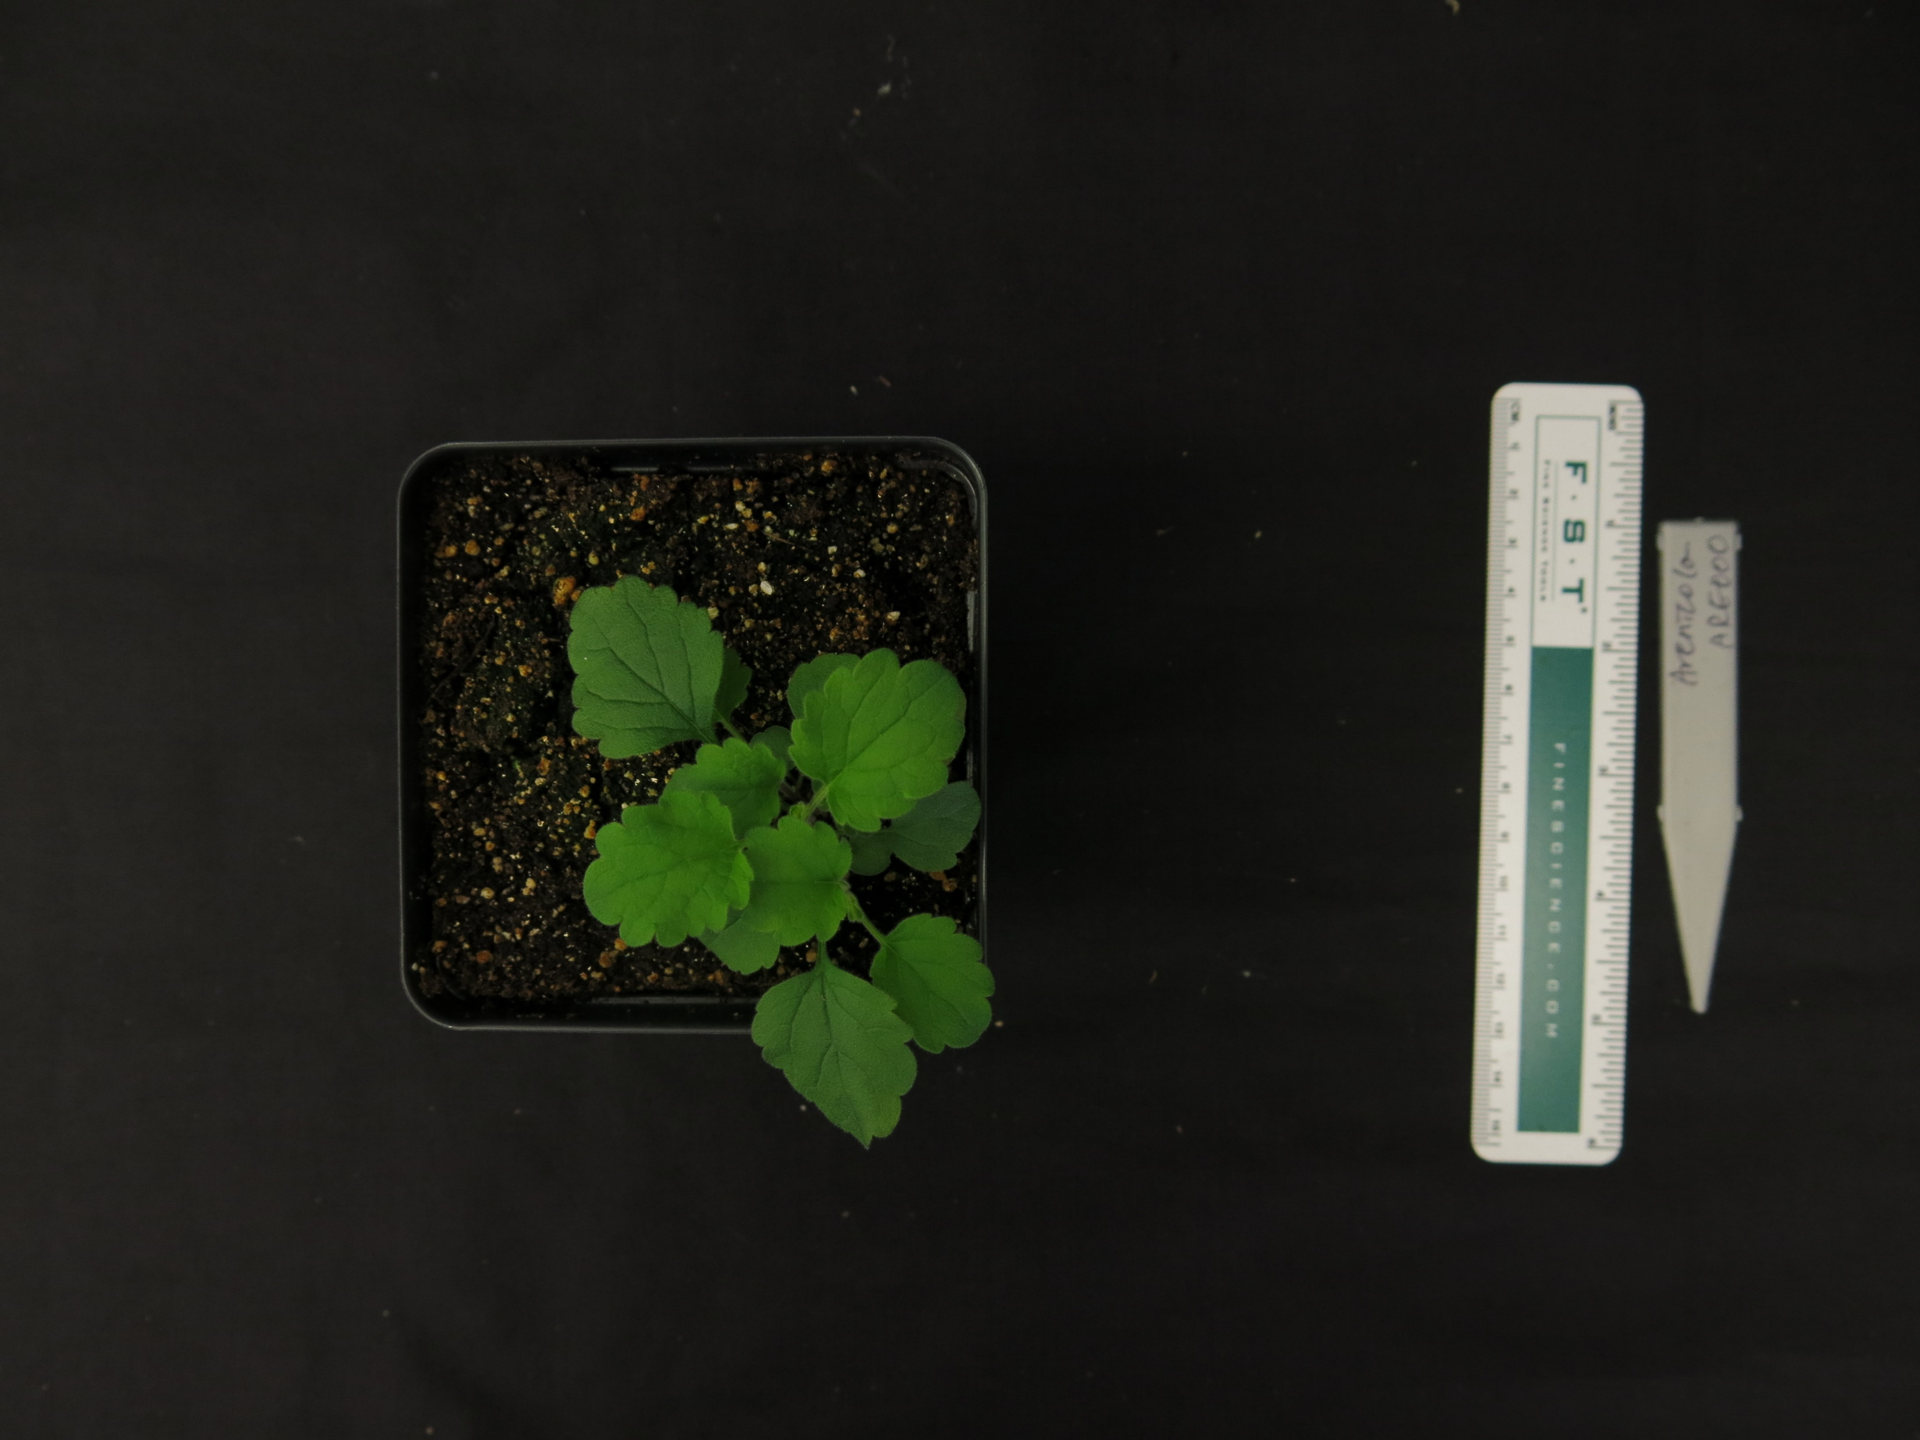
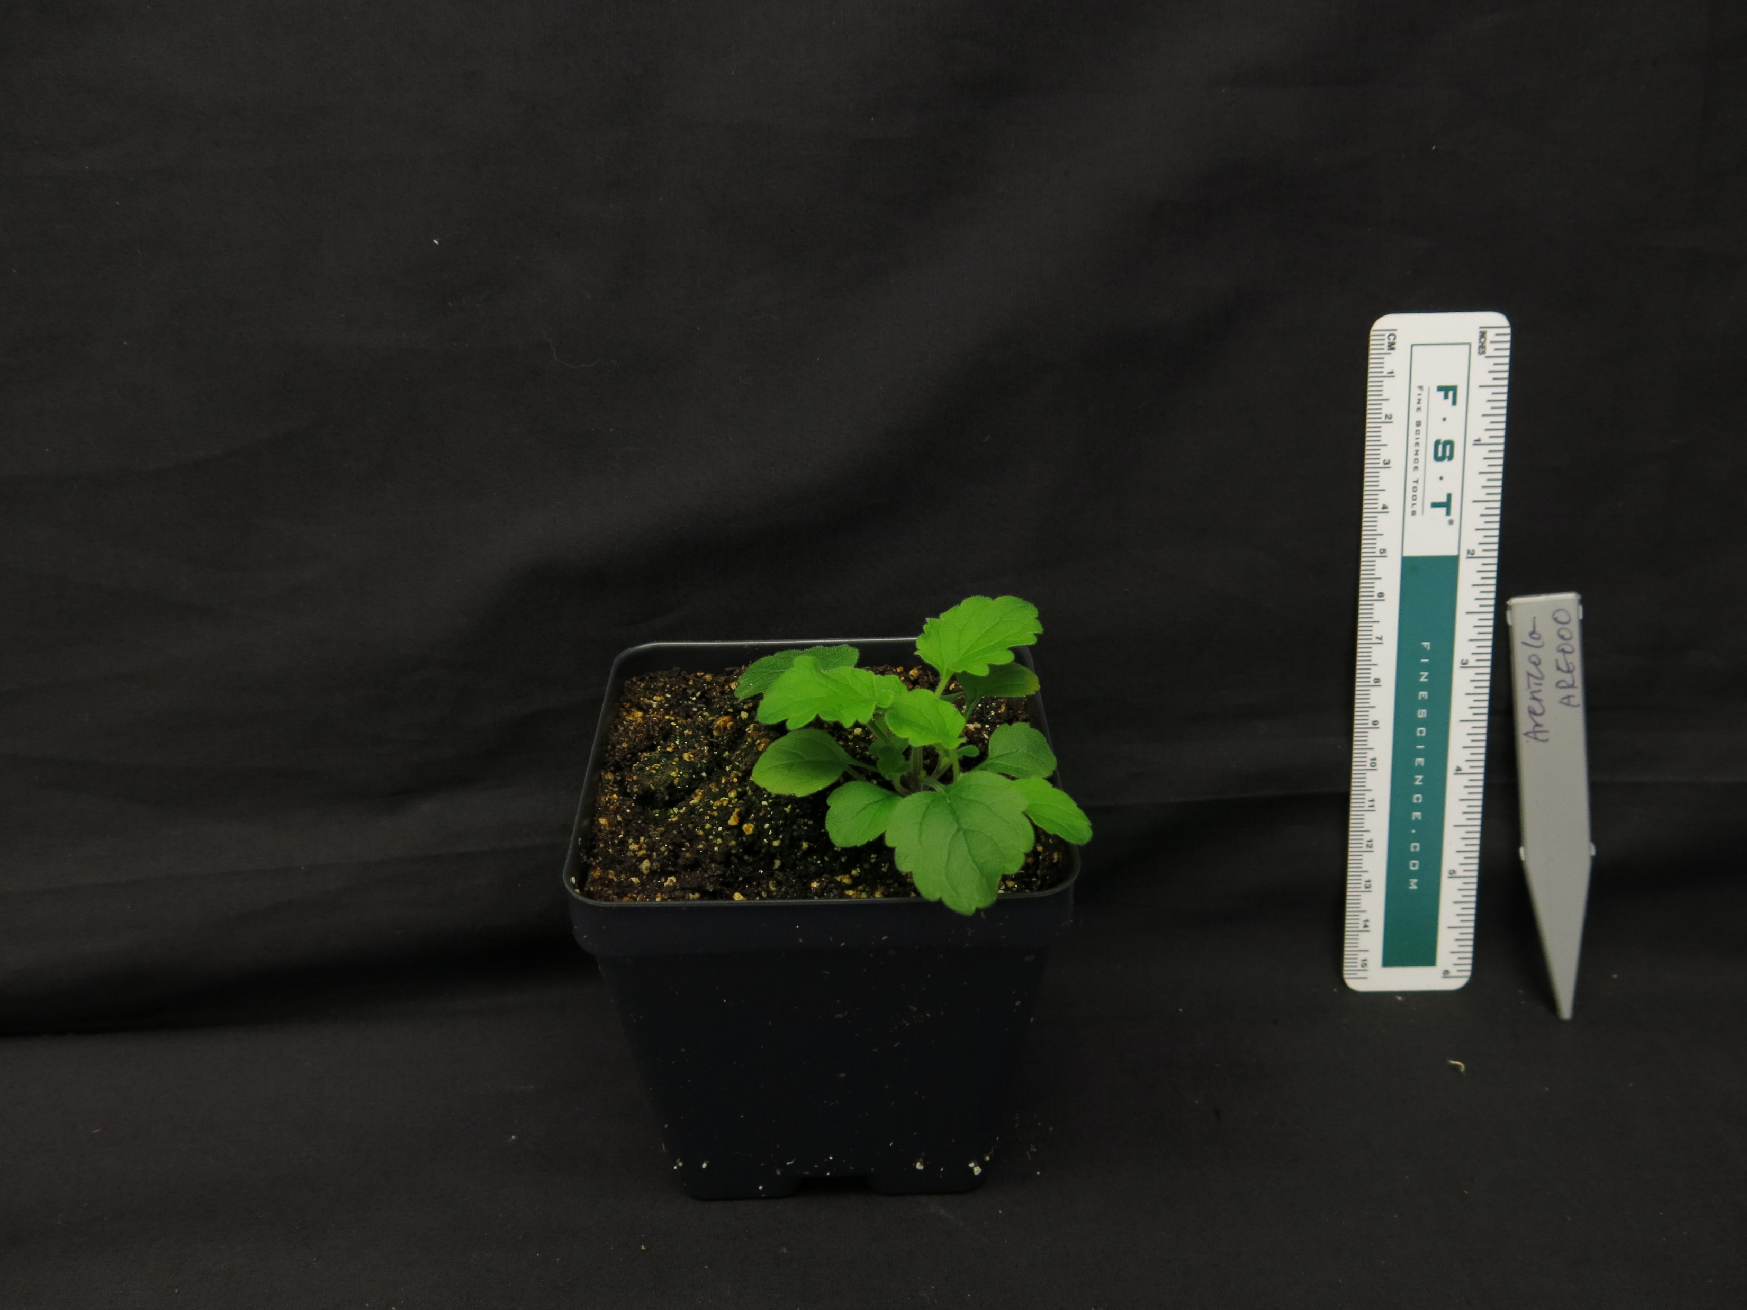
Scutellaria arenicola (40 days)

Slide 3
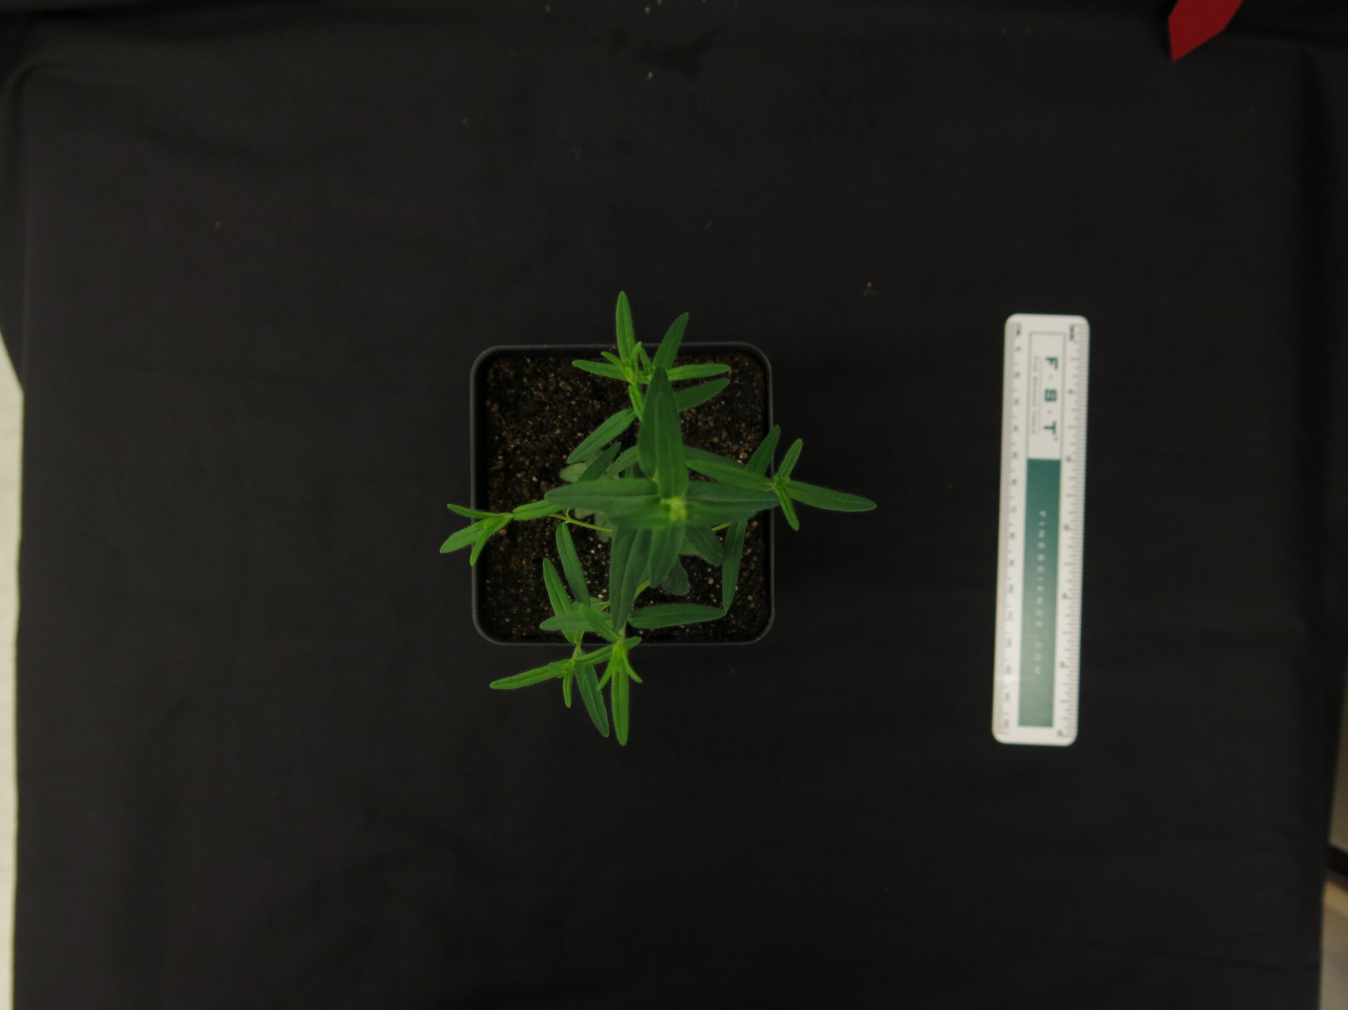
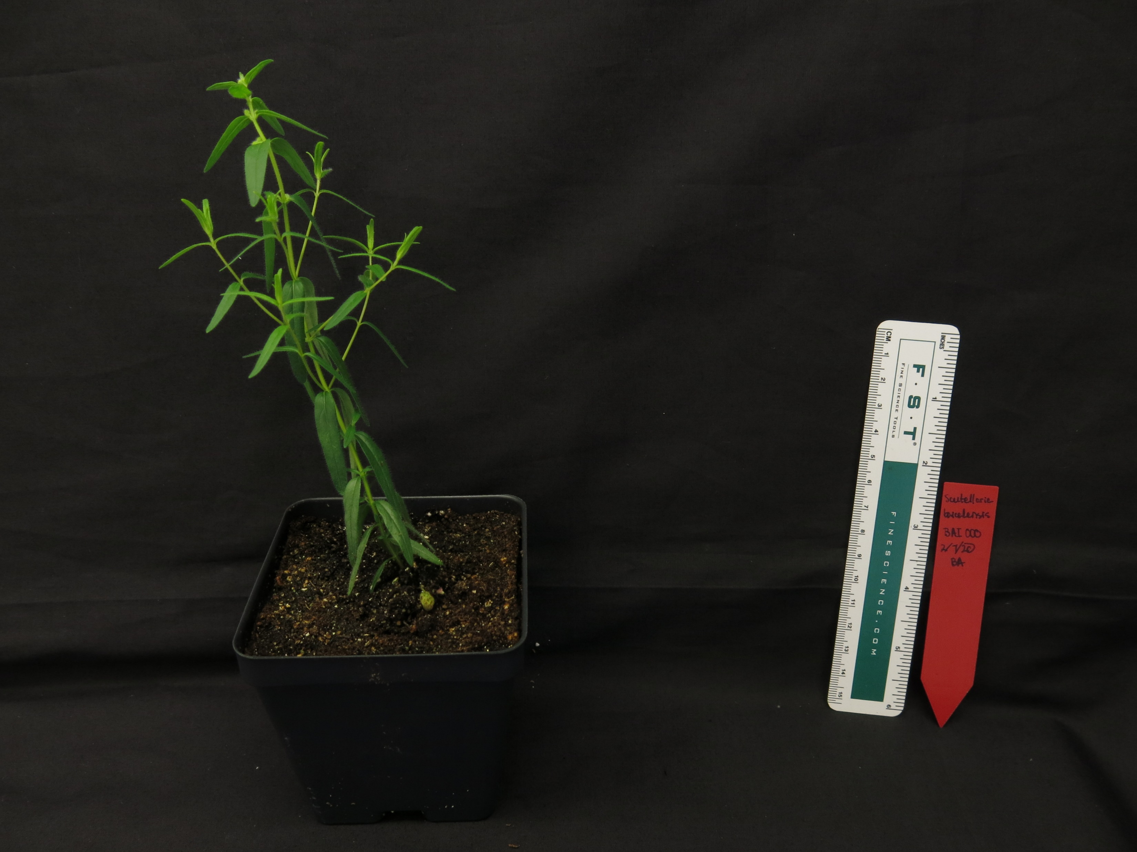
Scutellaria baicalensis (40 days)

Slide 4
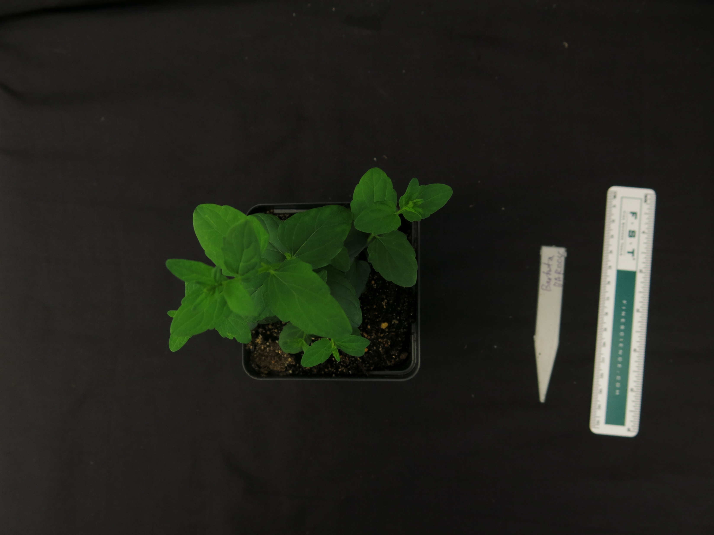
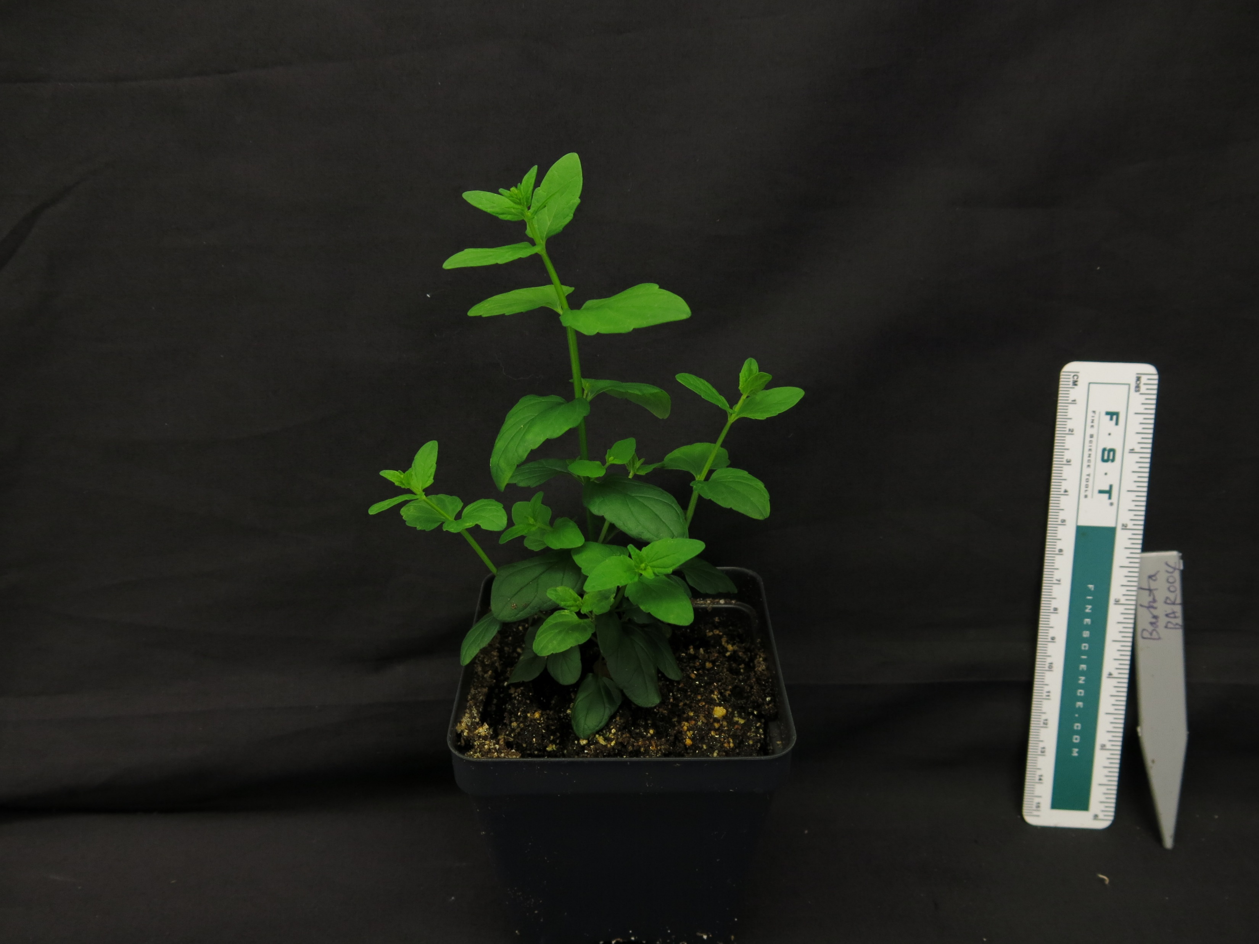
Scutellaria barbata (40 days)

Slide 5
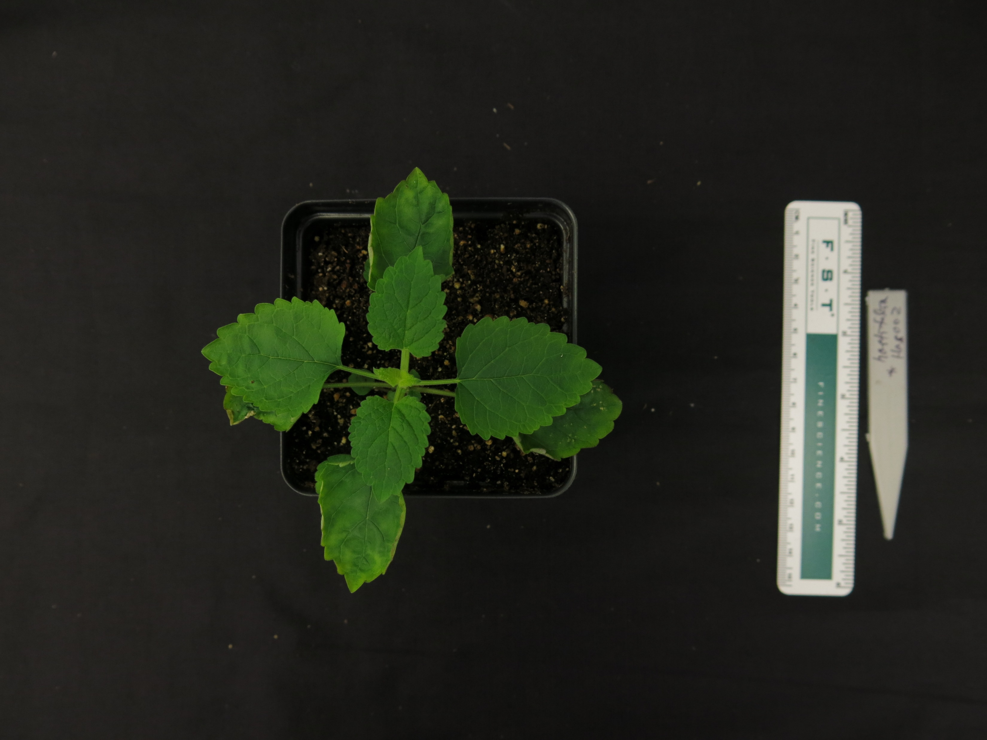
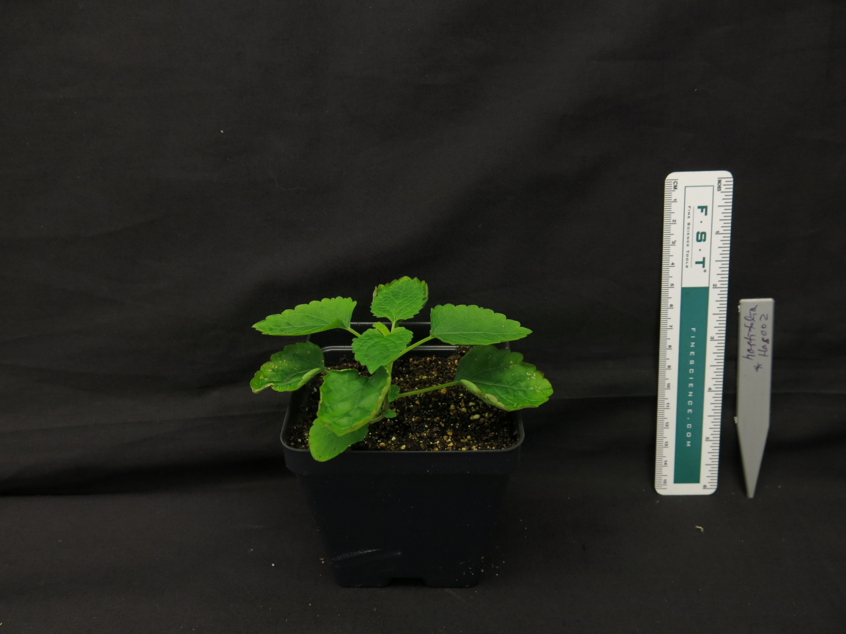
Scutellaria hastifolia (40 days)

Slide 6
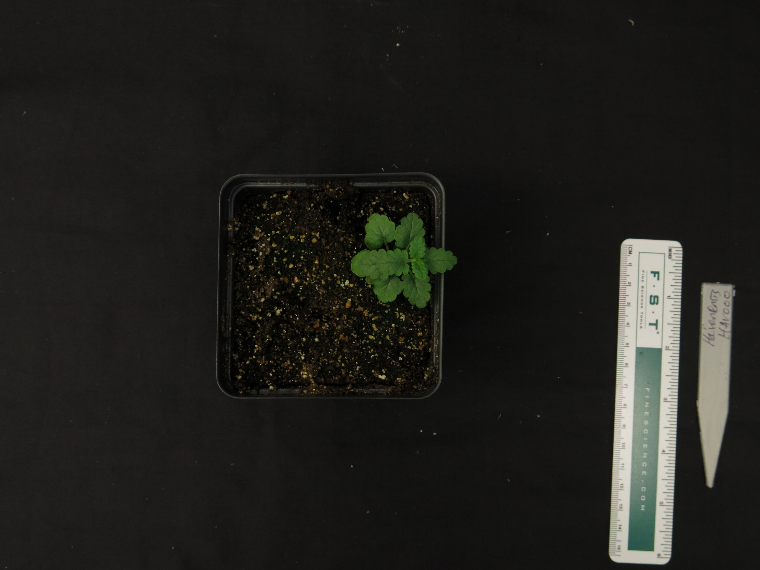
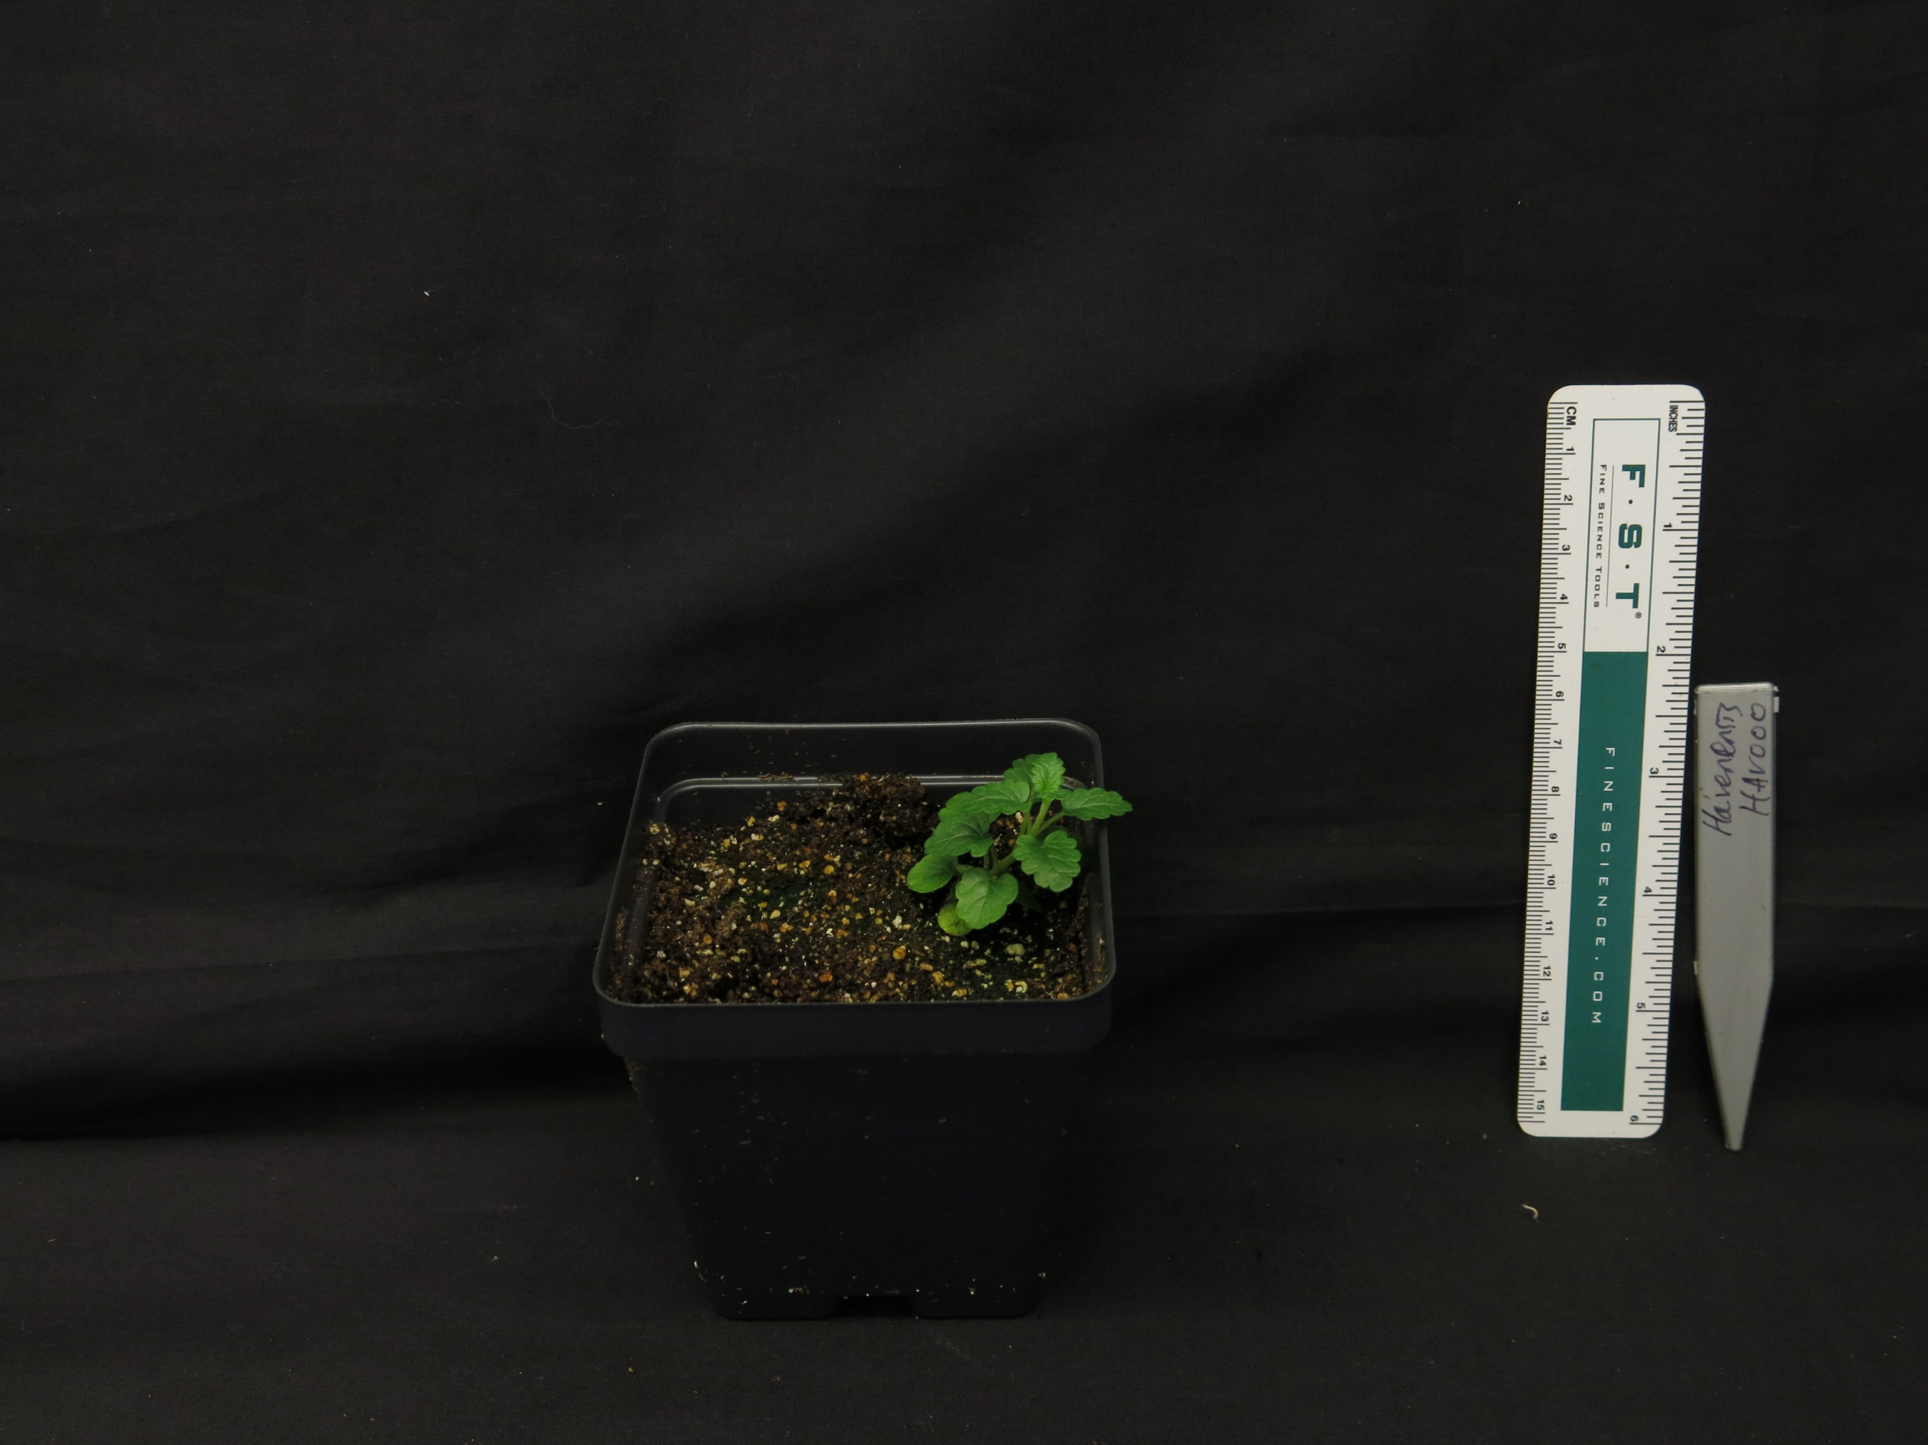
Scutellaria havanesis (40 days)

Slide 7
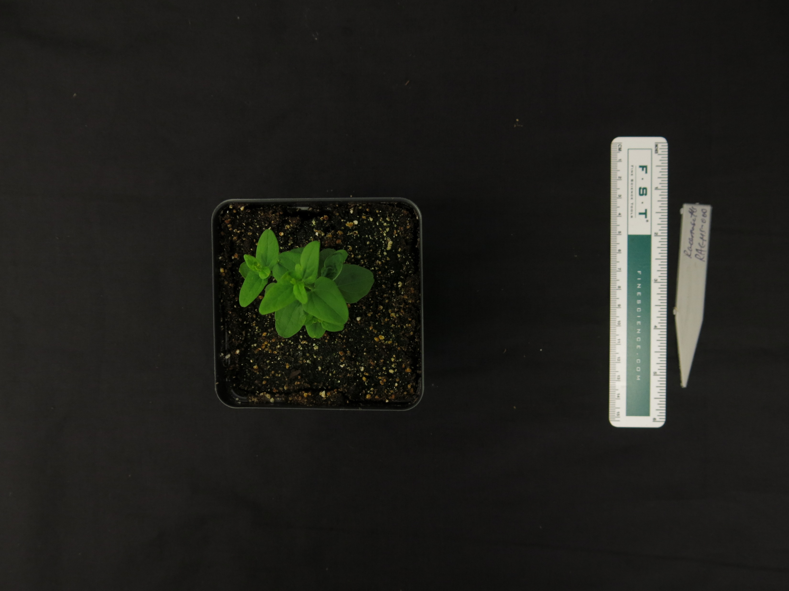
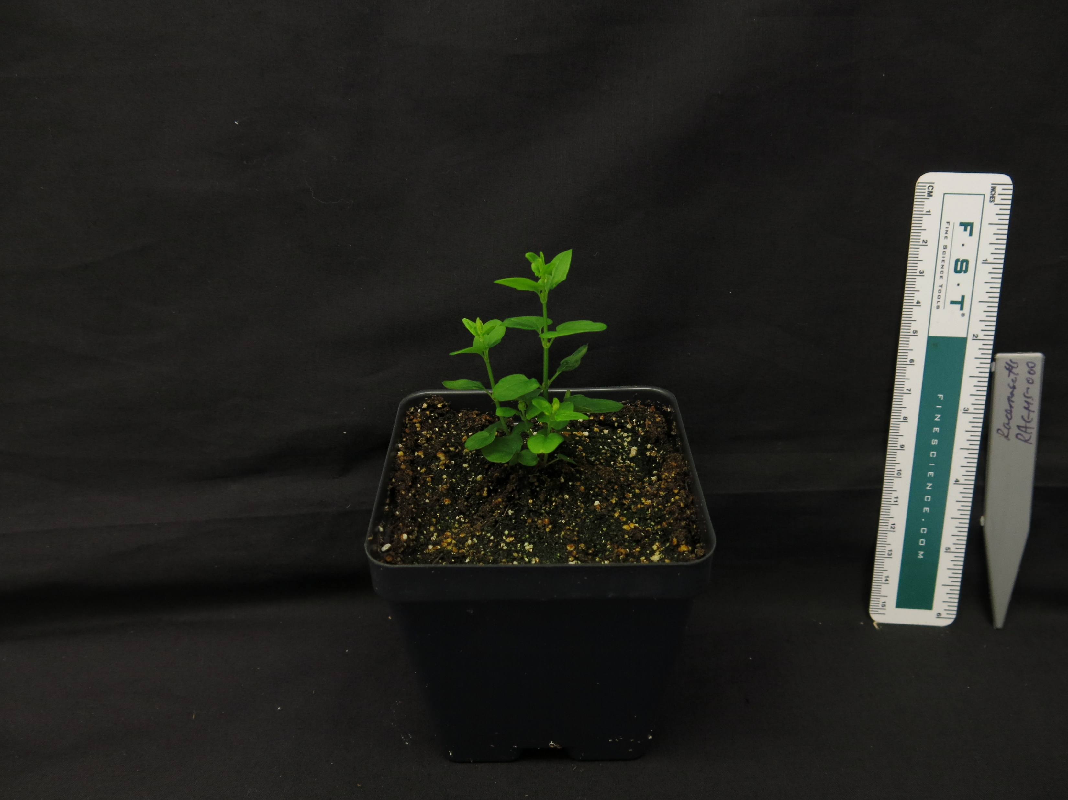
Scutellaria racemosa (40 days)

Slide 8
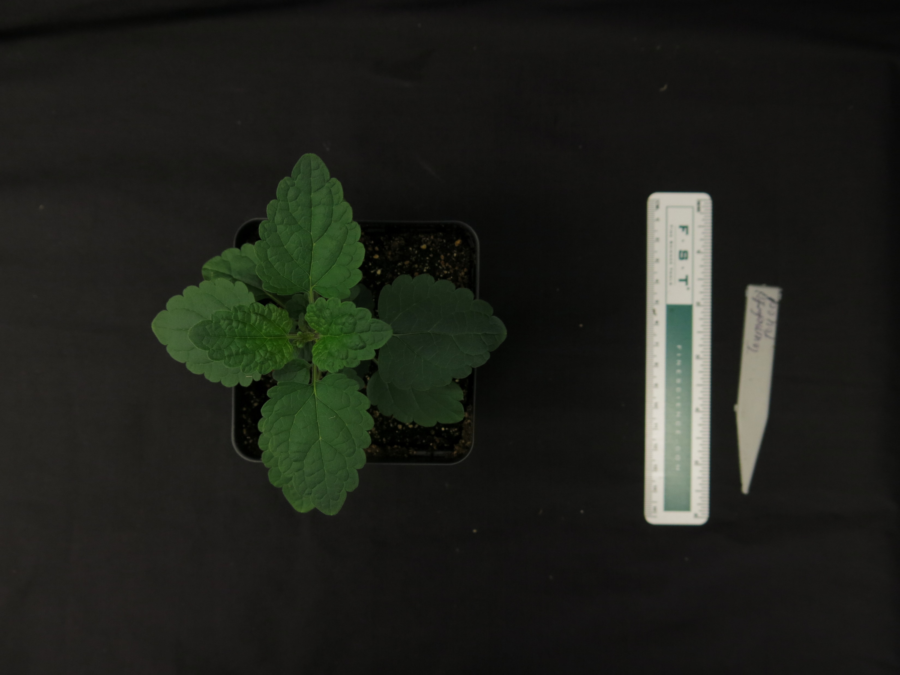
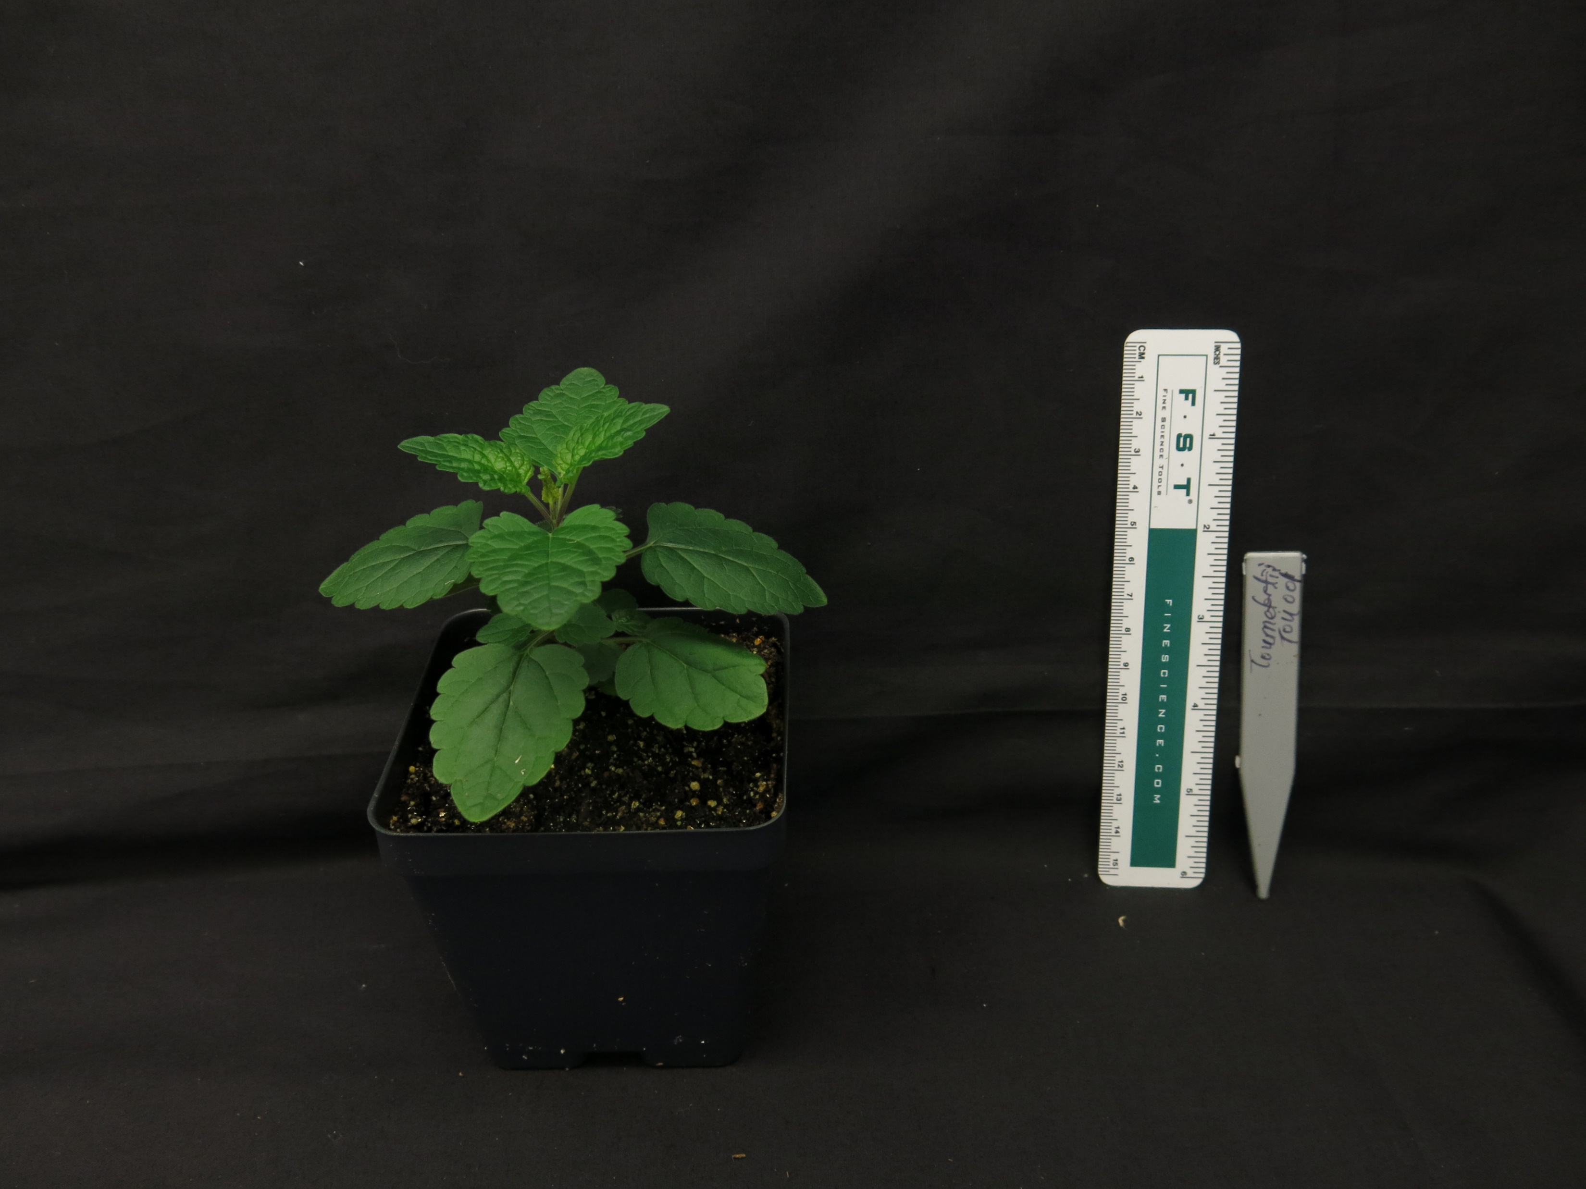
Scutellaria tournefortii (40 days)

Slide 9
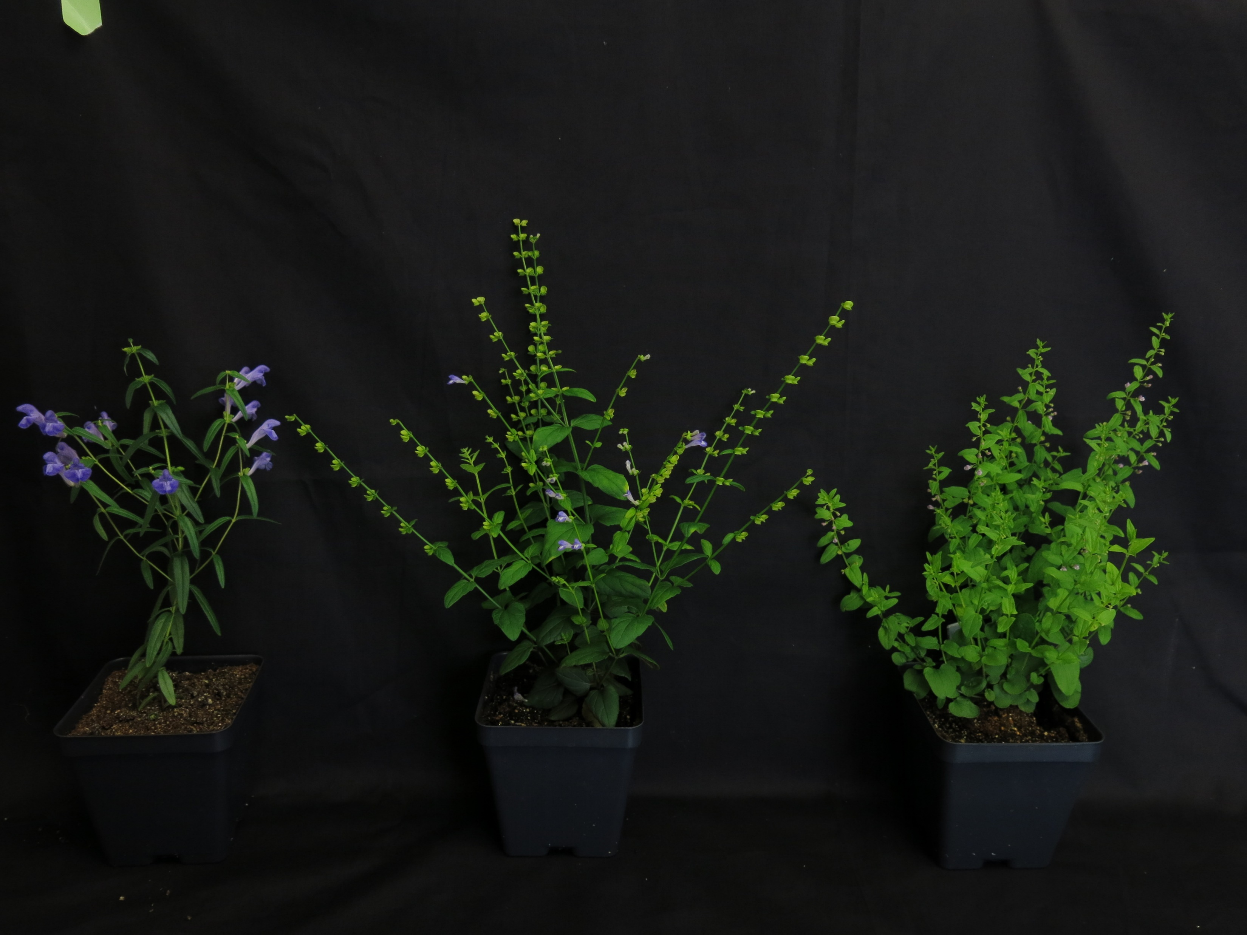
S. baicalensis, S. barbata, and S. racemosa (60 days)
S. baicalensis
S. barbata
S. racemosa

Slide 10
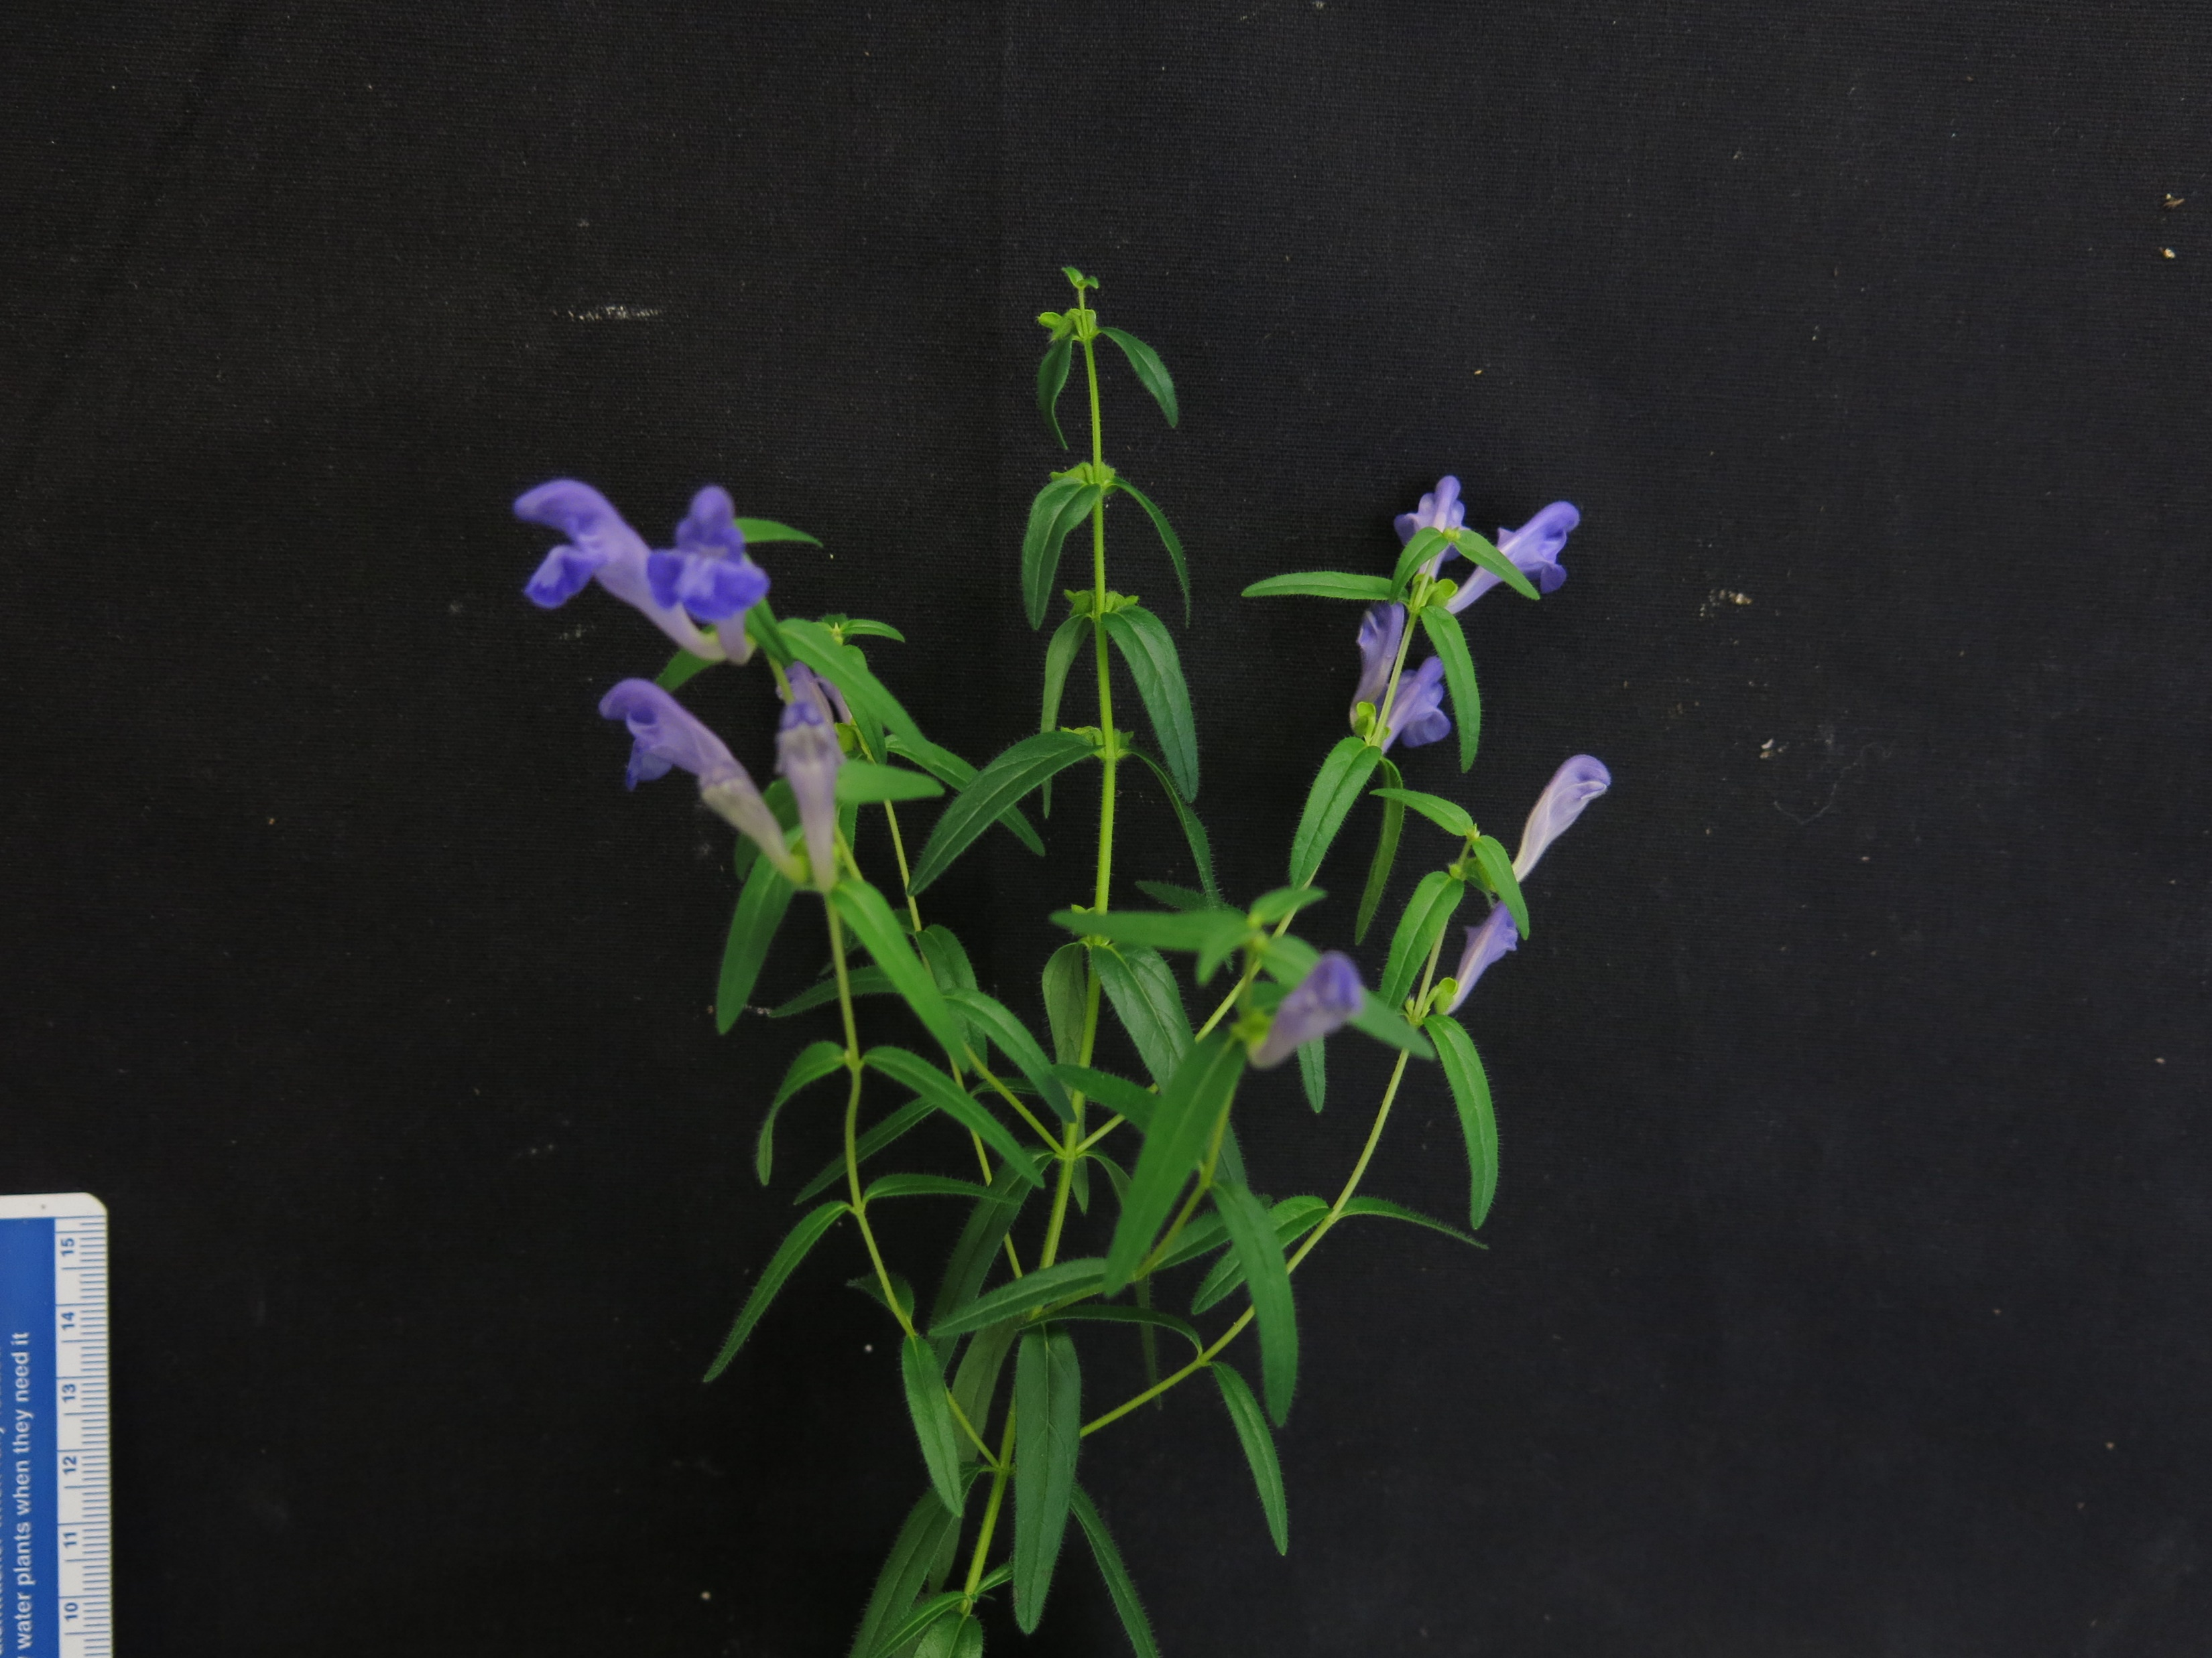
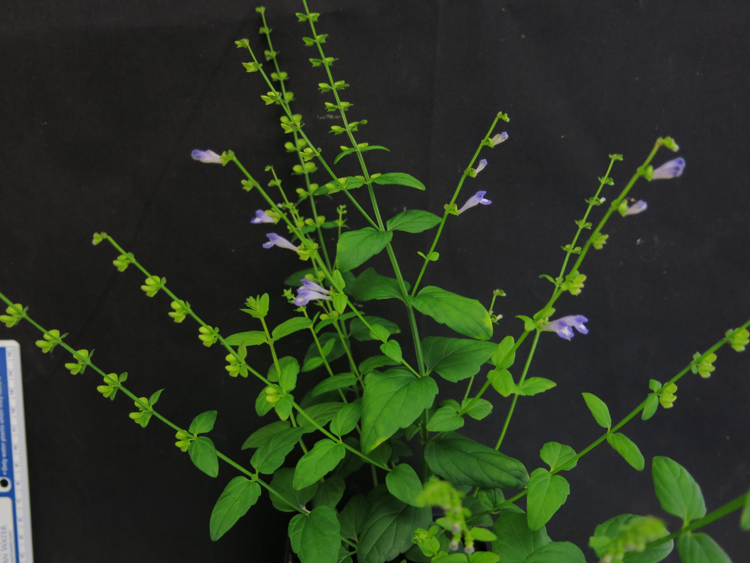
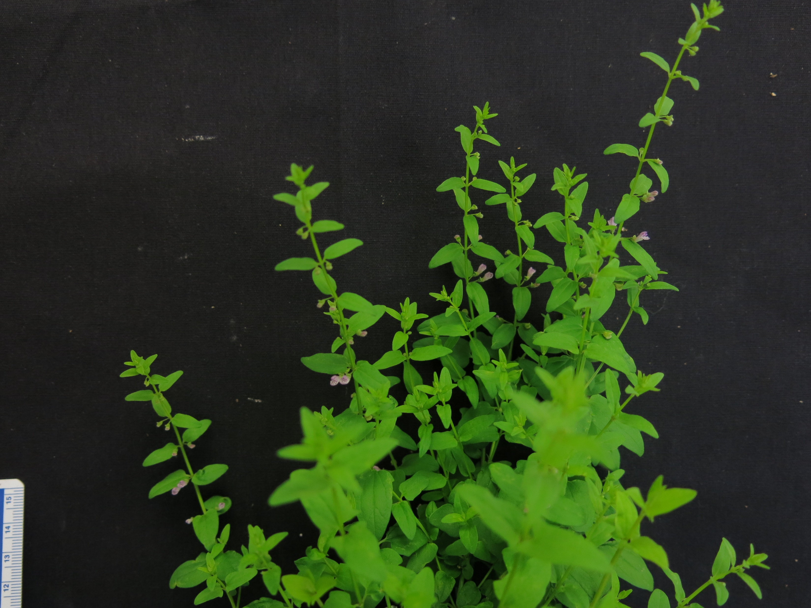
S. baicalensis, S. barbata, and S. racemosa (60 days)
S. baicalensis
S. barbata
S. racemosa

Slide 11
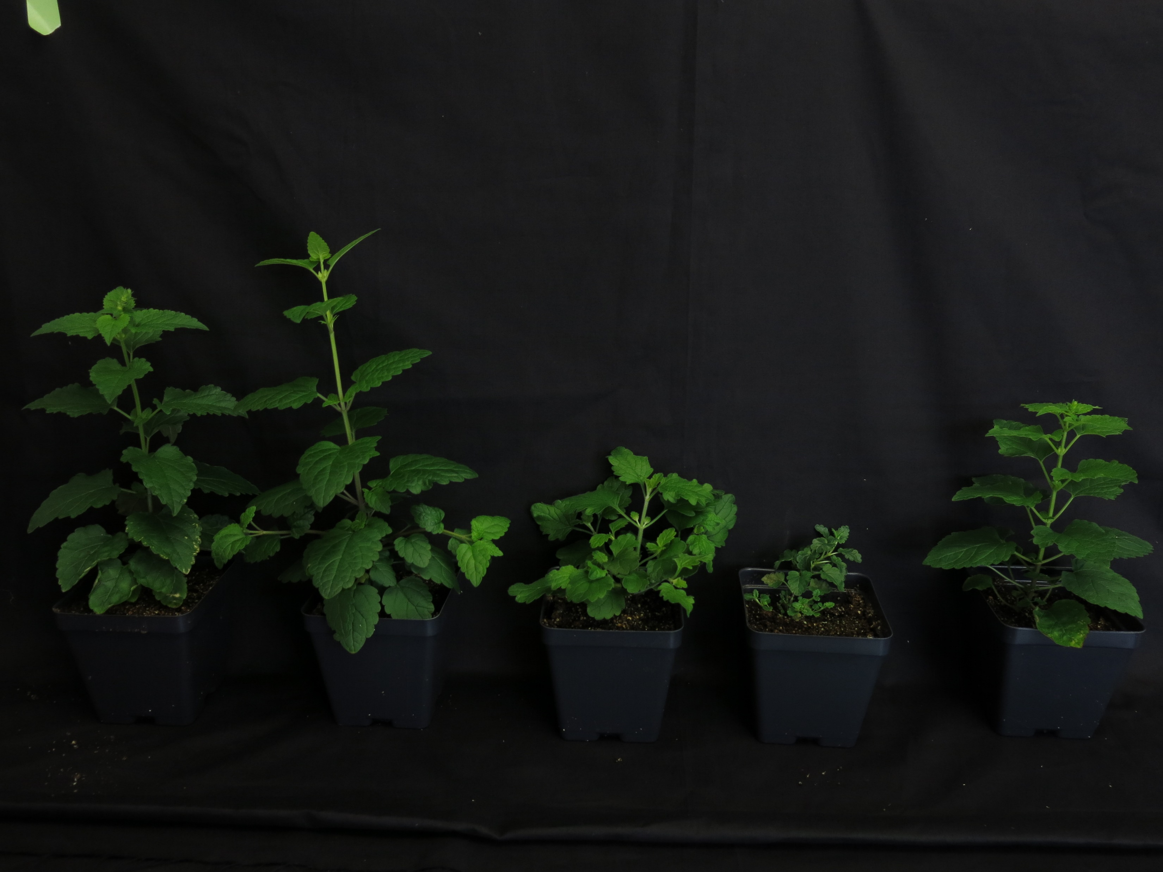
S. altissima, S. tournefortii, S. arenicola, S. havanesis, and S. hastifolia (60 days)
S. altissima
S. arenicola
S. hastifolia
S. tournefortii
S. havanesis

Slide 12
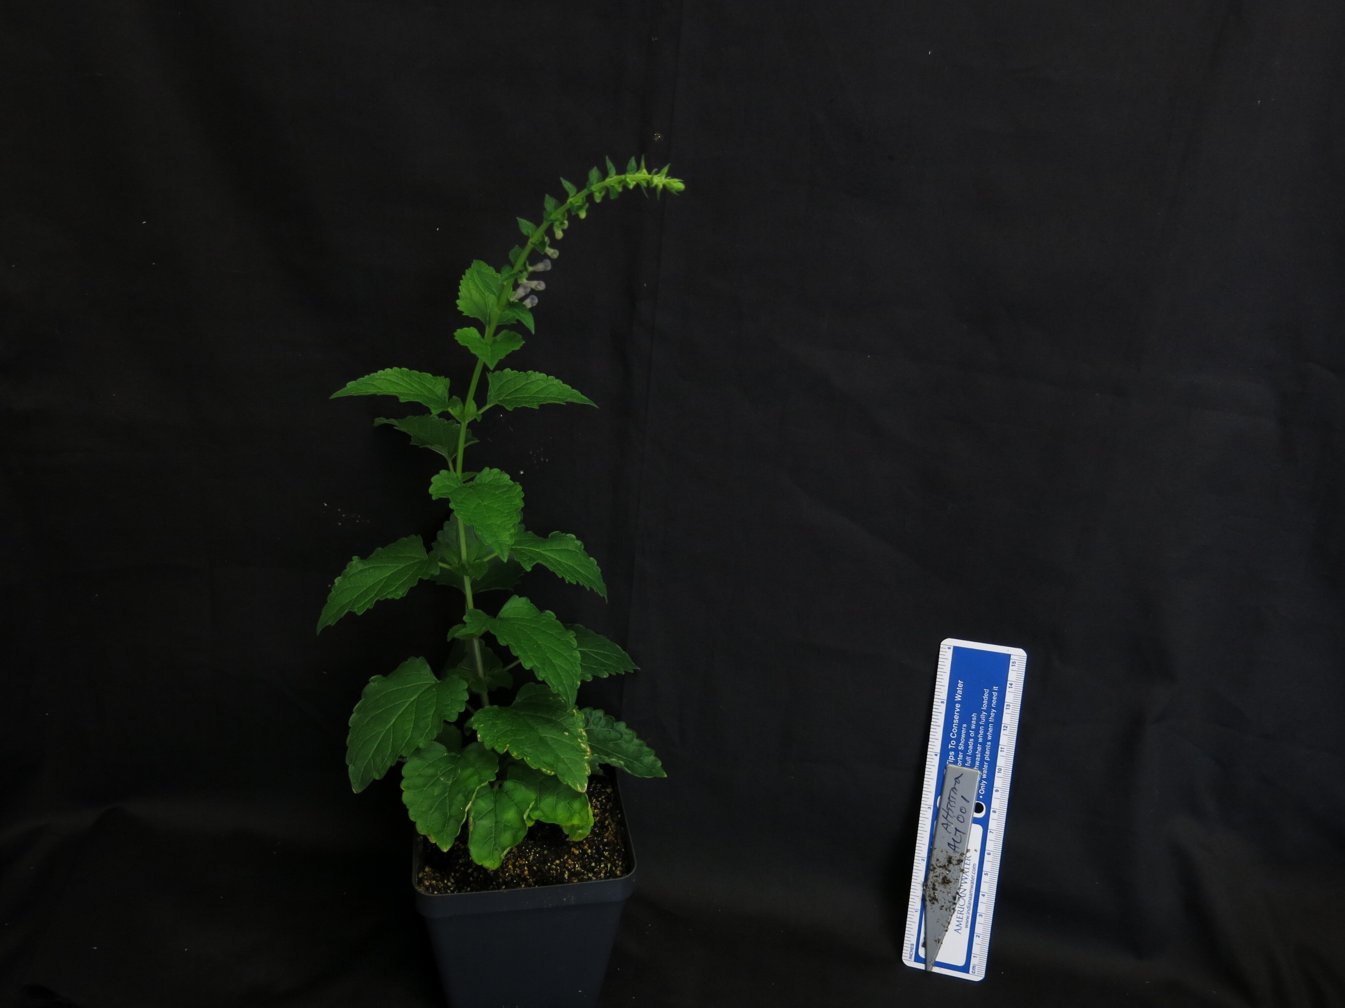
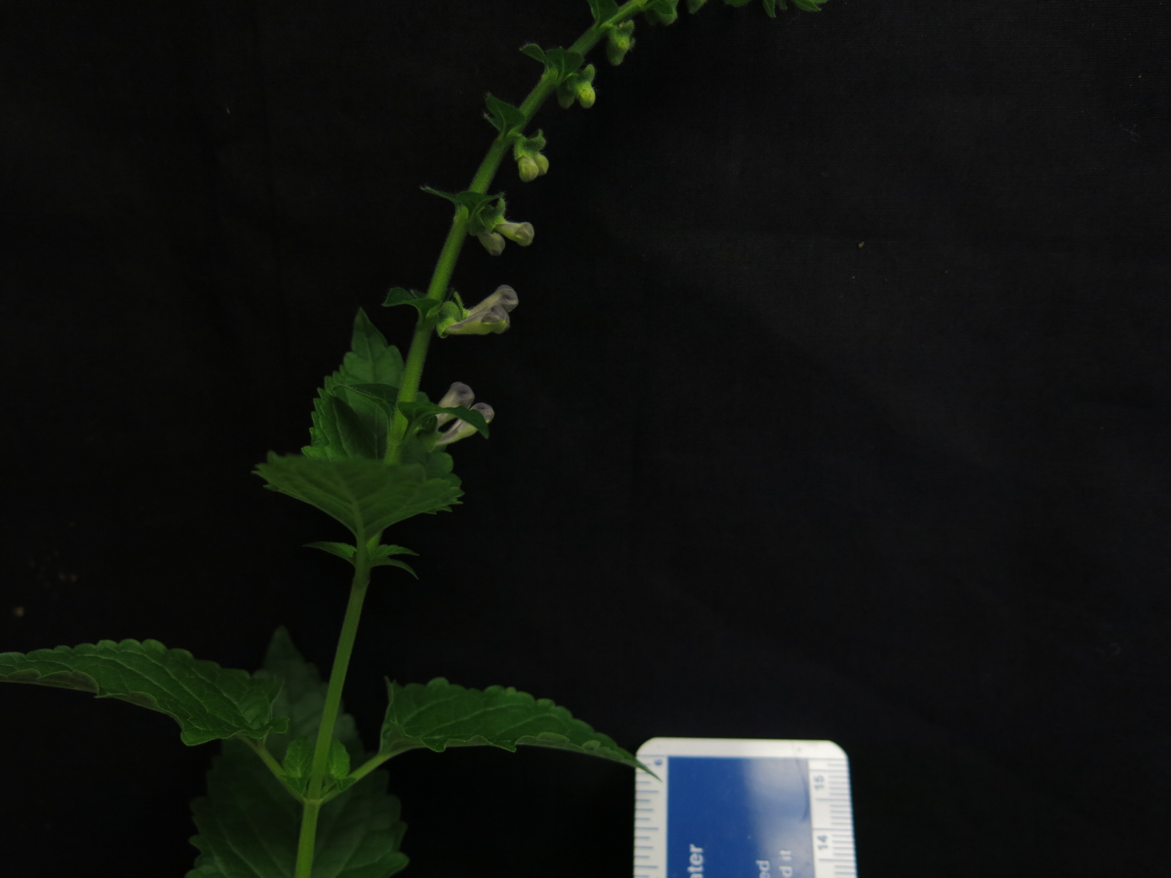
Scutellaria altissima (75 days)

Slide 13
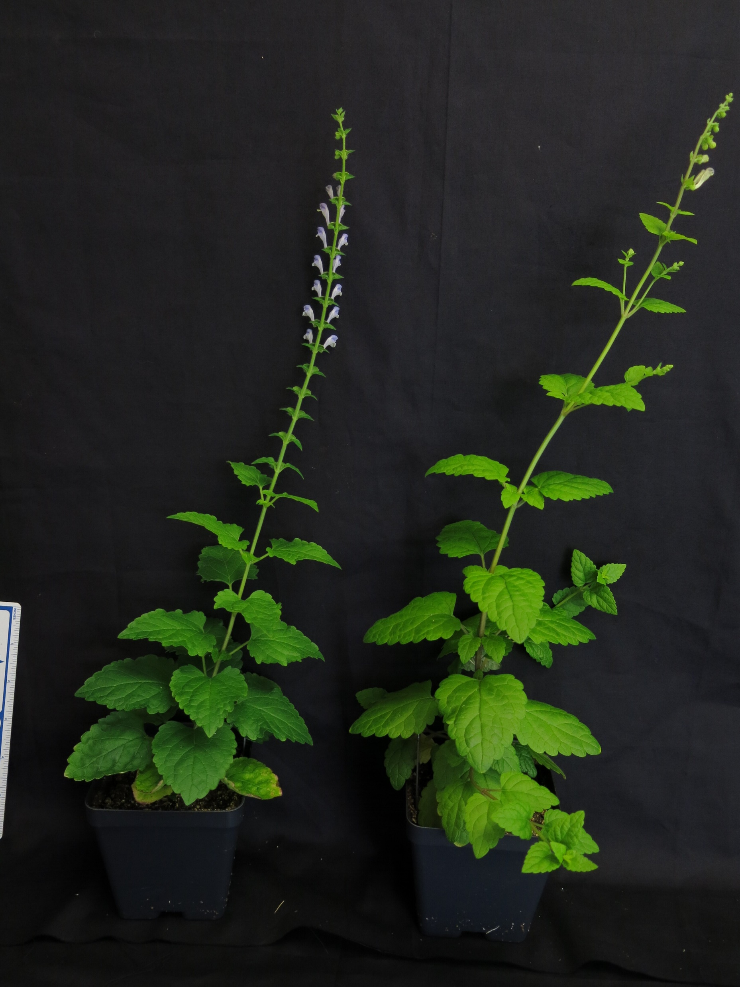
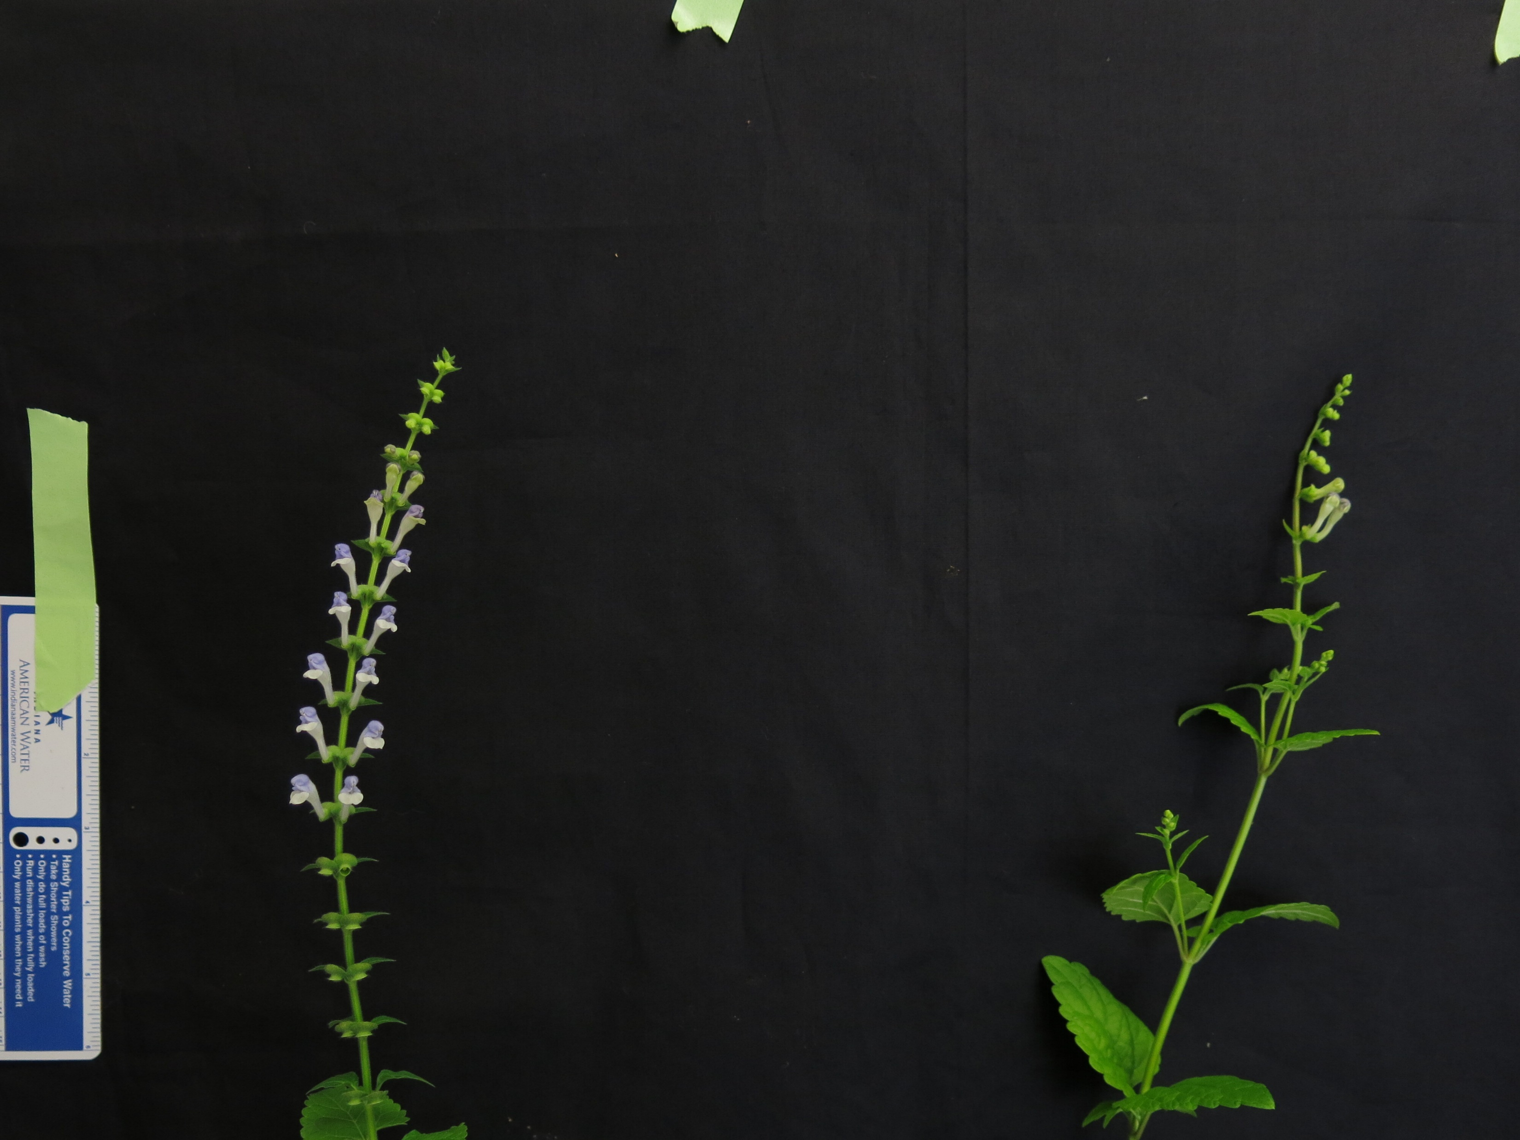
S. hastifolia and S. tournefortii (75 days)
S. hastifolia
S. tournefortii
S. hastifolia
S. tournefortii

Slide 14
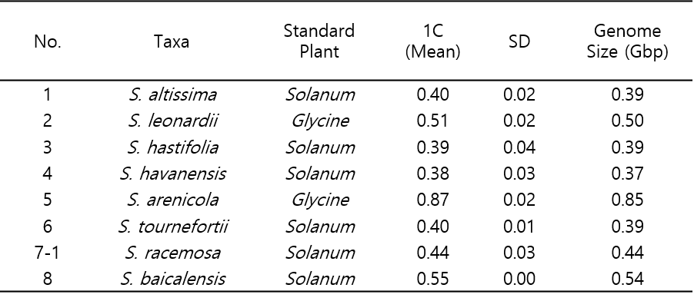

Slide 15
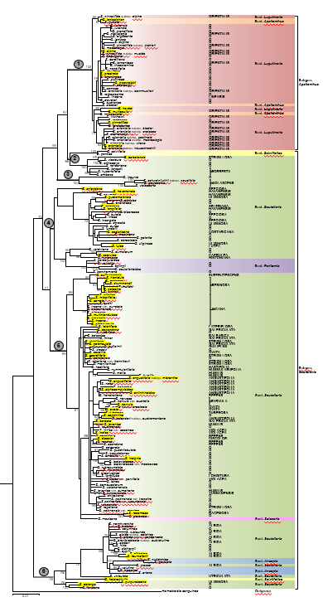
Phylogenetic tree – see other ppt file for full size

Slide 16
S. baicalensis flavonoid pathway

Slide 17
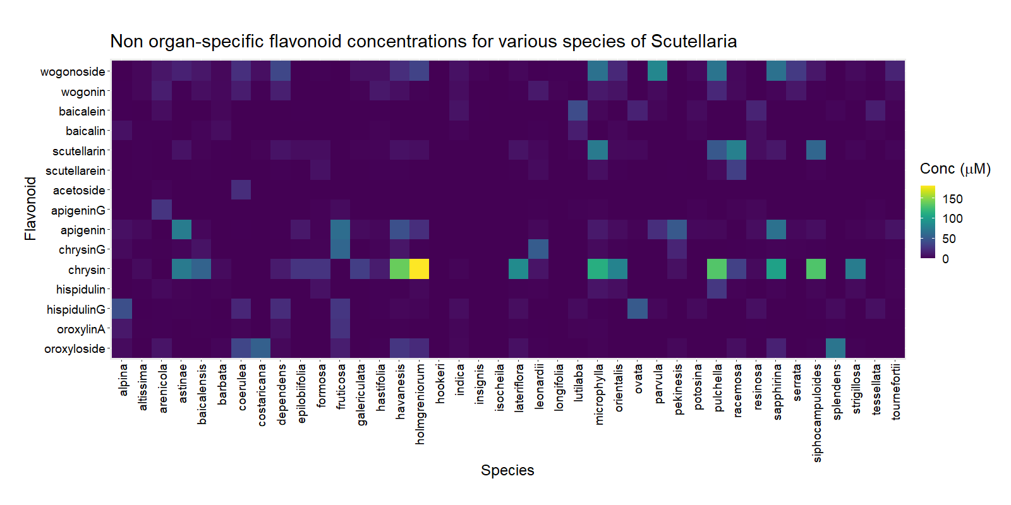

Slide 18
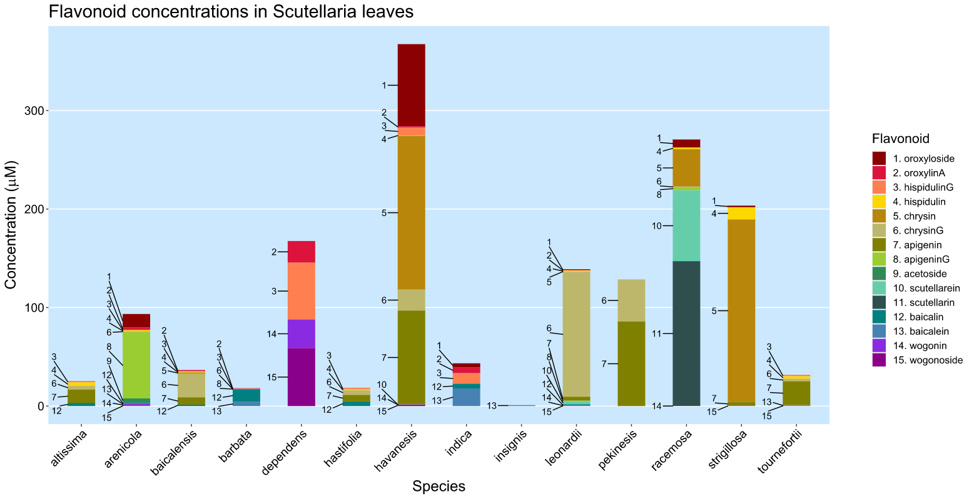

Slide 19
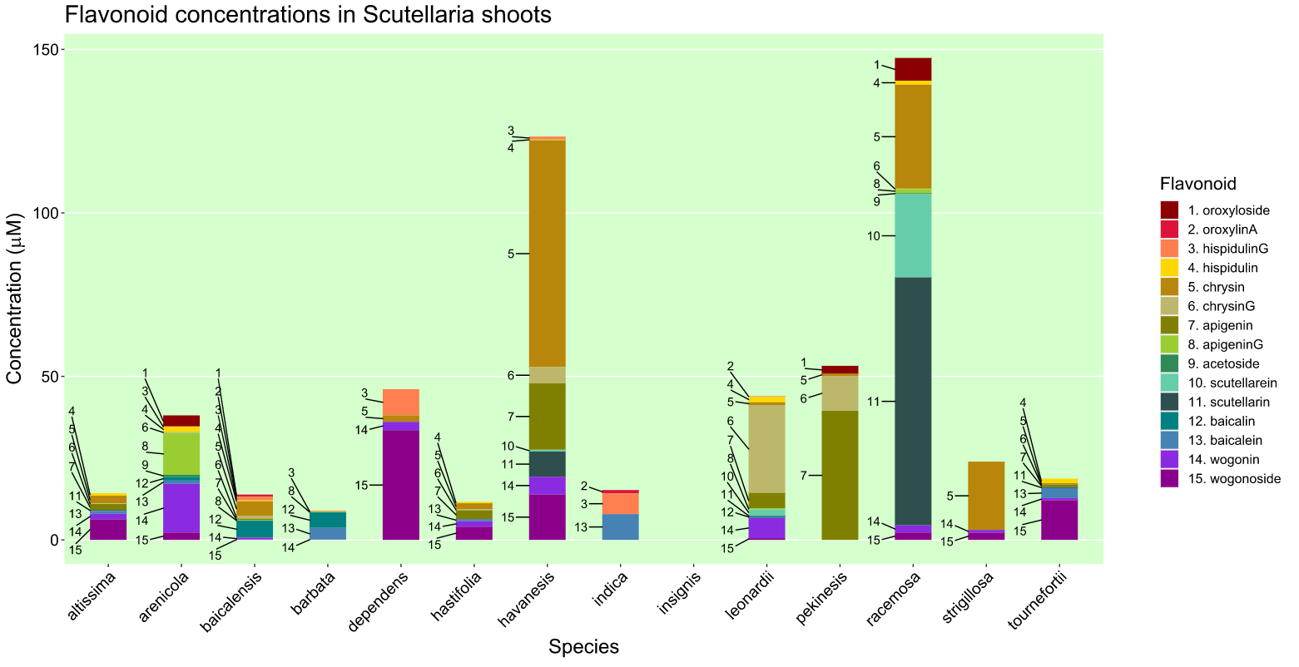

Slide 20
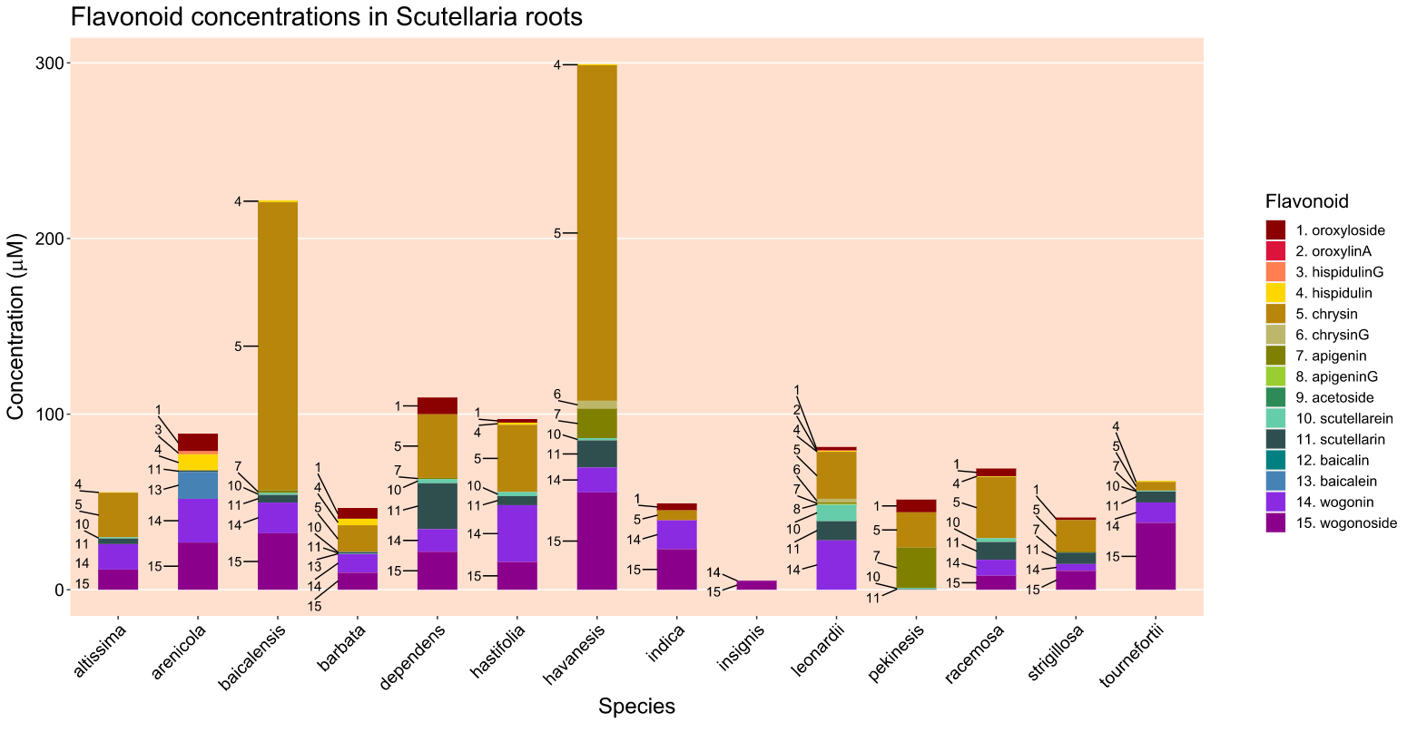

Slide 21
Species | Reads mapped | Reads mapped and paired | SNPs | Indels
altissima | 51% | 45% | 4806017 | 45672
barbata | 52% | 45% | 5955047 | 74204
havanesis | 65% | 60% | 6867385 | 275630
racemosa | 49% | 43% | 5987918 | 72433
For alignment to baicalensis reference genome with bwa algorithm and variant calling with mapping quality and base quality > 20

